Slide 1
Reece Doyle
T1A2 – Portfolio Website

Slide 2
Inspiration

Slide 3
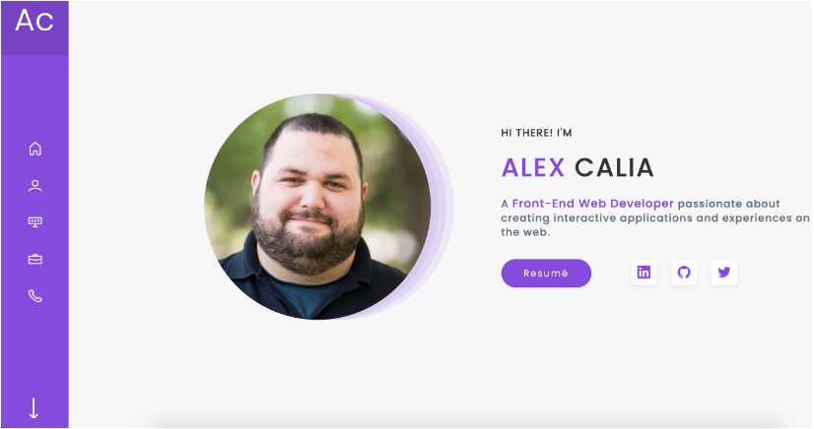

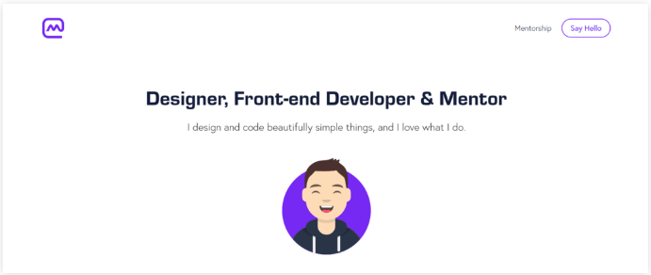
Inspiration
These were the designs I thought looked effective, and somewhat within my skillset.

Slide 4
Colours

Slide 5
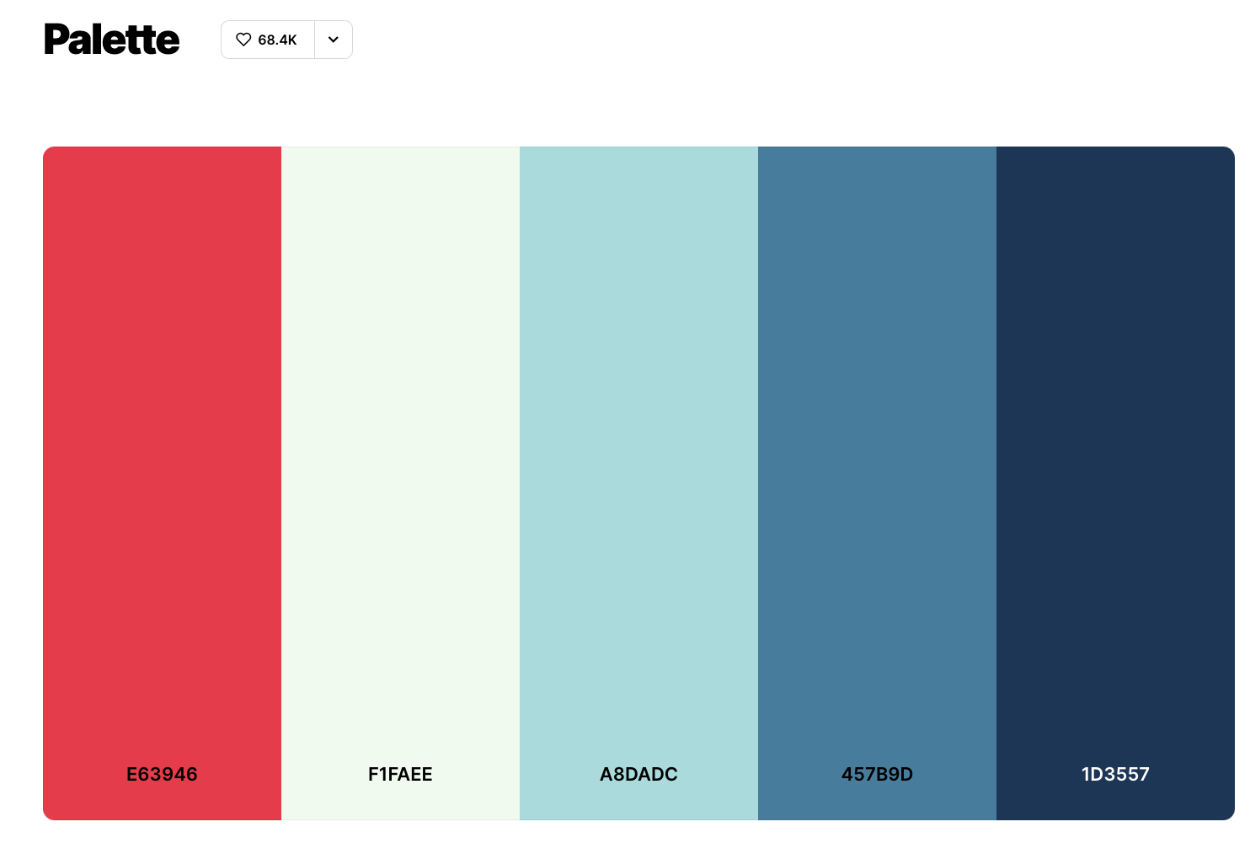
Colour Palette
I picked a trending palette from Coolors.co
I liked the 3 shades of blue juxtaposed with the red.
More sophisticated version of the Newcastle Knights colours.
Didn’t end up using the off-white colour.

Slide 6
Logo

Slide 7




Logo
I tried to design a logo that looked like code.
Unfortunately, my attempts at using a free online tool looked terrible...
However, I did like the concept, so I decided that I just would make this with text.

Slide 8
Components

Slide 9
Components
I wanted my website to feature the following components:
Logo: Intended to function as the home button and to give myself a brand that a client or potential employer might remember.
Navbar: To demonstrate that I can make a website easy to navigate
Contact page: A call to action. For people who want me to get back to them.
Footer on every page: My socials can be clicked and linked to once the viewer decides they’d like to know more about me or contact me directly without the contact page.
Phone number link for mobile: If viewed on a phone you could call me to chat straight away.
Entertaining blog posts and tongue in cheek CV: I’ve always benefited most when I’ve leaned into my personality and sense of humour. This could be my point of difference between myself and another candidate for a job.

Slide 10
Sitemap

Slide 11


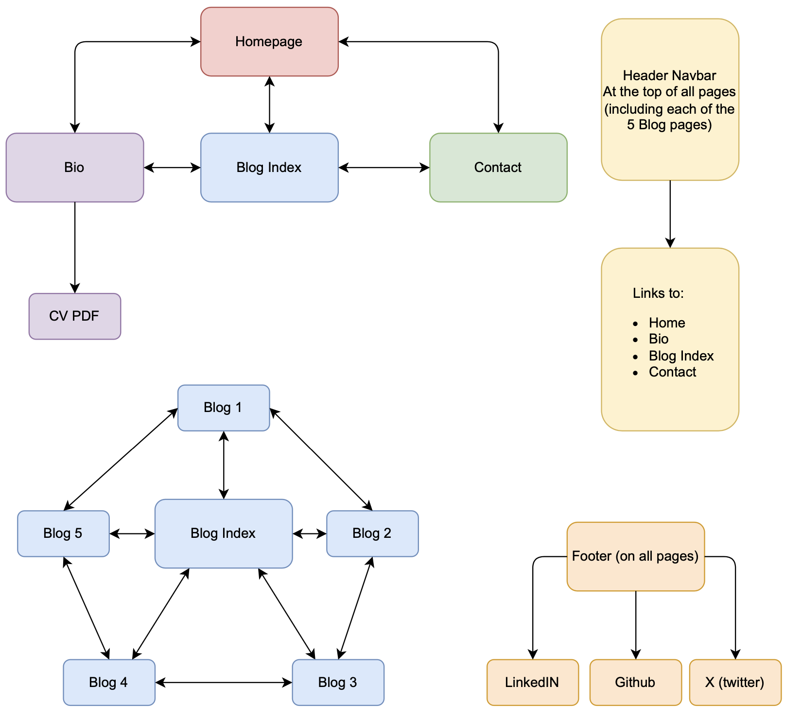



Sitemap

Slide 12
Sitemap
Four Main Pages
Homepage
Bio Page (with link to CV PDF)
Blog Index
Contact

Slide 13
Sitemap
Four Main Pages
Homepage
Bio Page (with link to CV PDF)
Blog Index
Contact
Blog Index Page
Access to all 5 Blogpost pages
‘Next’ & ‘Previous’ nav buttons
Link back to Blog Index

Slide 14
Sitemap
Four Main Pages
Homepage
Bio Page (with link to CV PDF)
Blog Index
Contact
Header
Logo as link to homepage
Button links:
Bio
Blog
Contact
At the top of all pages
Blog Index Page
Access to all 5 Blogpost pages
‘Next’ & ‘Previous’ nav buttons
Link back to Blog Index

Slide 15
Sitemap
Four Main Pages
Homepage
Bio Page (with link to CV PDF)
Blog Index
Contact
Header
Logo as link to homepage
Button links:
Bio
Blog
Contact
At the top of all pages
Blog Index Page
Access to all 5 Blogpost pages
‘Next’ & ‘Previous’ nav buttons
Link back to Blog Index
Footer
Links to my:
LinkedIn
GitHub
X (twitter)
At the bottom of all pages

Slide 16
Wireframes

Slide 17
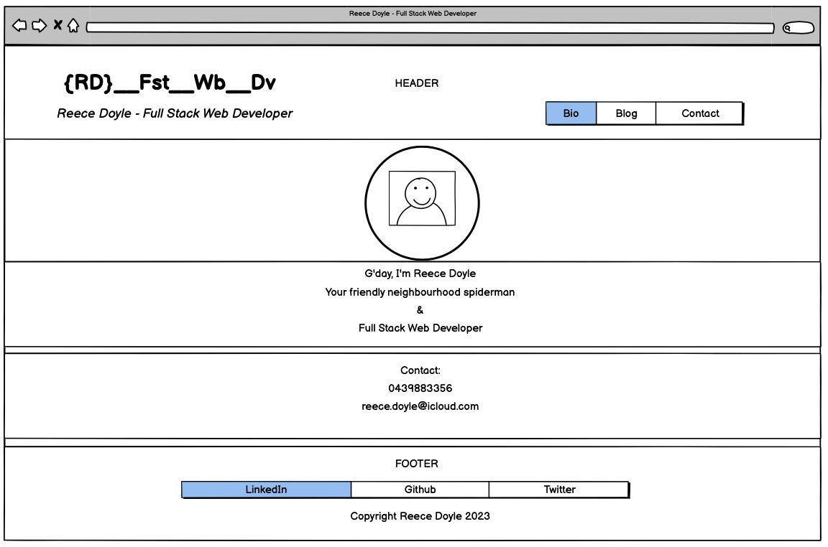
Homepage - Desktop

Slide 18
Homepage - Desktop
Header
Logo featuring link to Homepage
Navbar
Link to all other pages
Picture
Circular portrait
Contact Section
Phone Number and email
Greeting
Welcome text stating who I am and what I do
Footer
Links to socials and copyright

Slide 19
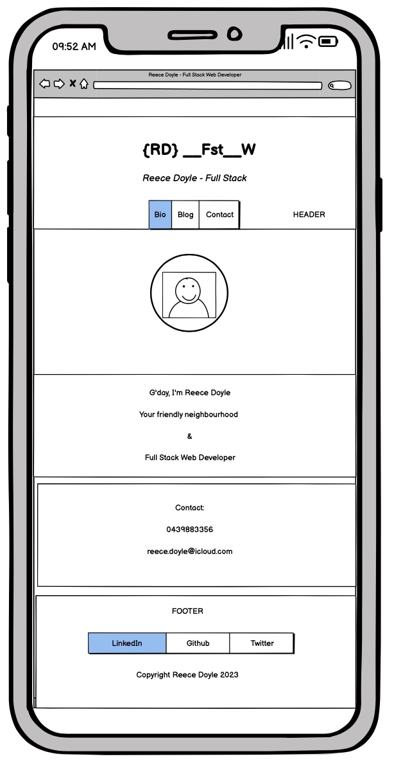
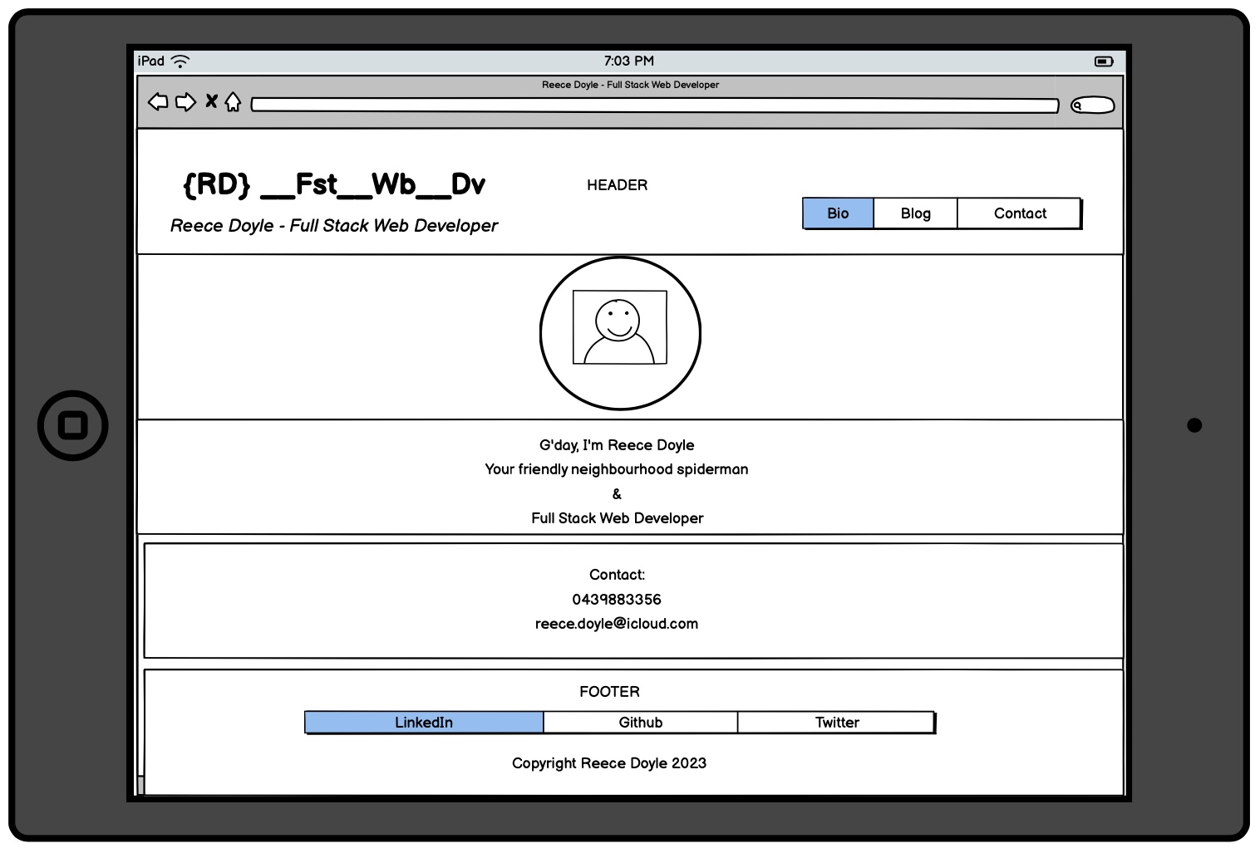
Homepage – Tablet and Mobile

Slide 20
Homepage – Tablet and Mobile
Mobile 600px Max
Header: align-items flex-start to centre
{RD} – 4rem to 2rem
_FSt_Wb_Dv – 3 rem to 1.5rem
Subtitle – 1.5 rem to 1 rem Reduced size of picture from 300px to 180px
Greeting and Contact Text from 2rem to 1.2rem
Footer required only Margin left and right: auto
Tablet
Flexbox everywhere!
Nothing to change

Slide 21
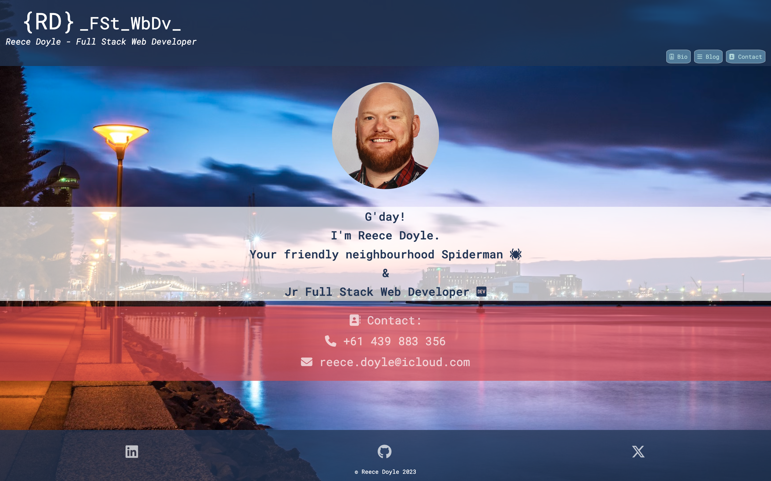
Homepage - Desktop

Slide 22
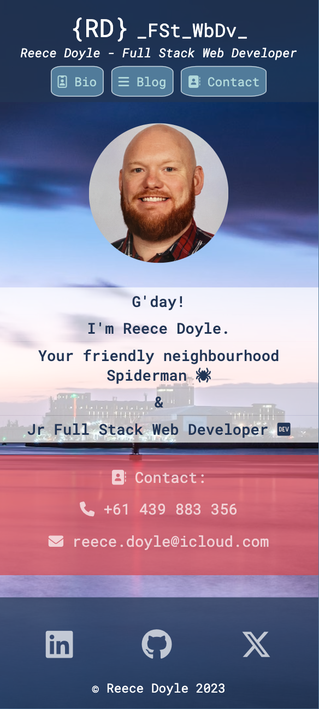
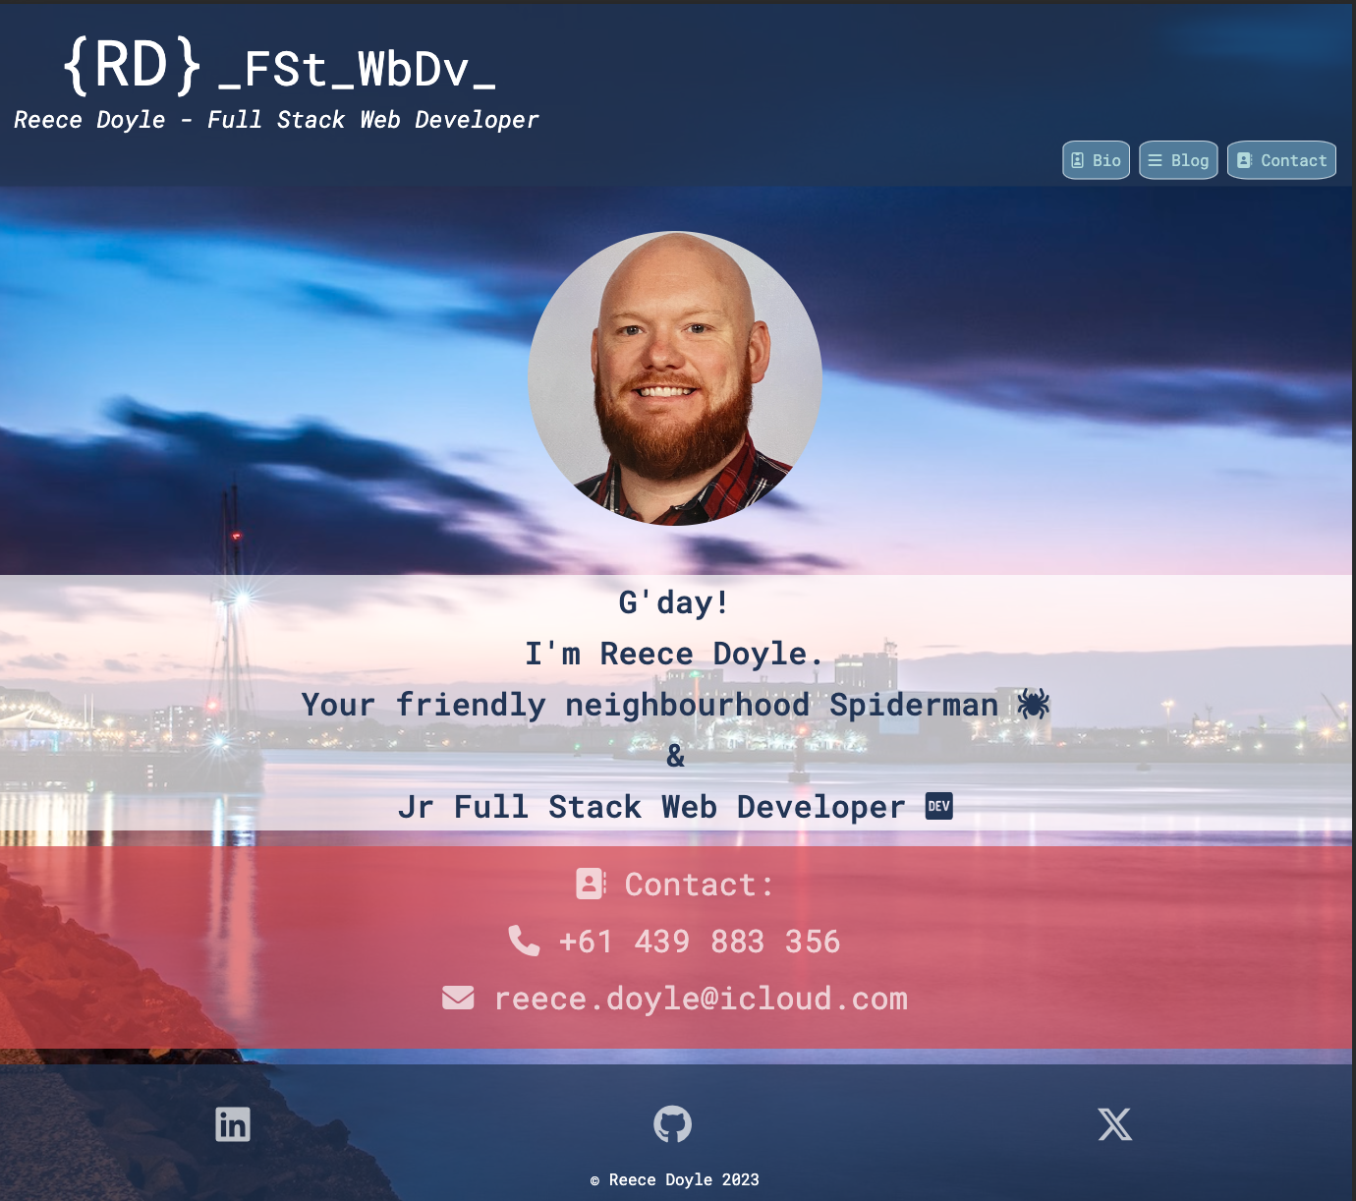
Homepage – Tablet and Mobile

Slide 23
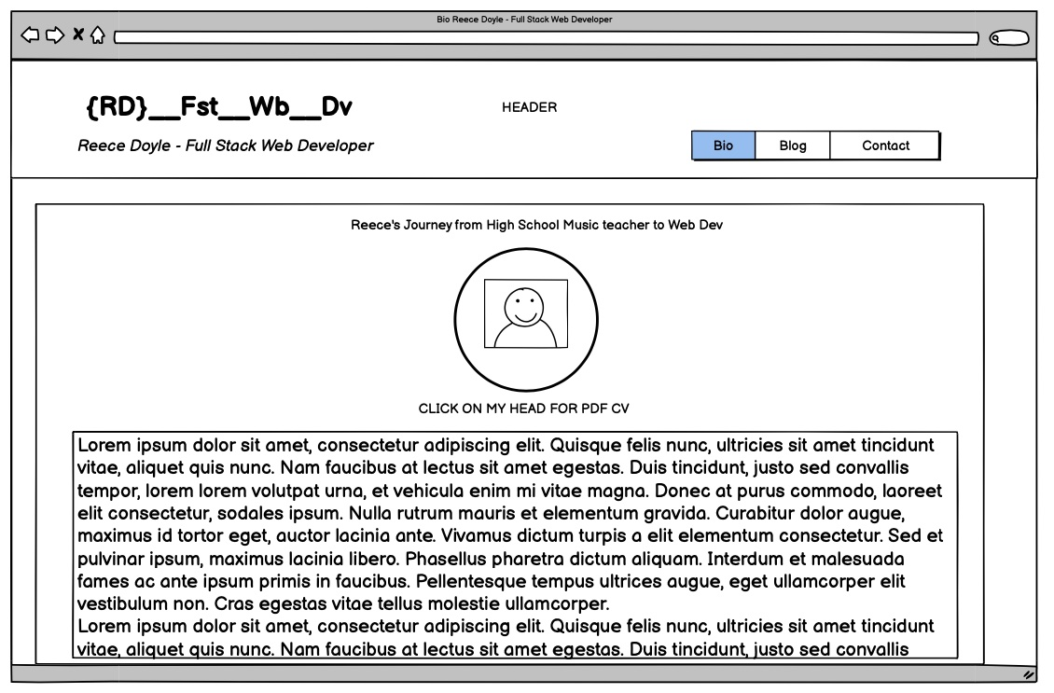
Bio - Desktop

Slide 24
Bio - Desktop
Bio Page
Different circular portrait is also a link to the PDF version of my CV
Bio section
Written by ChatGPT
Lots of UL and OL, <h> and <p>

Slide 25
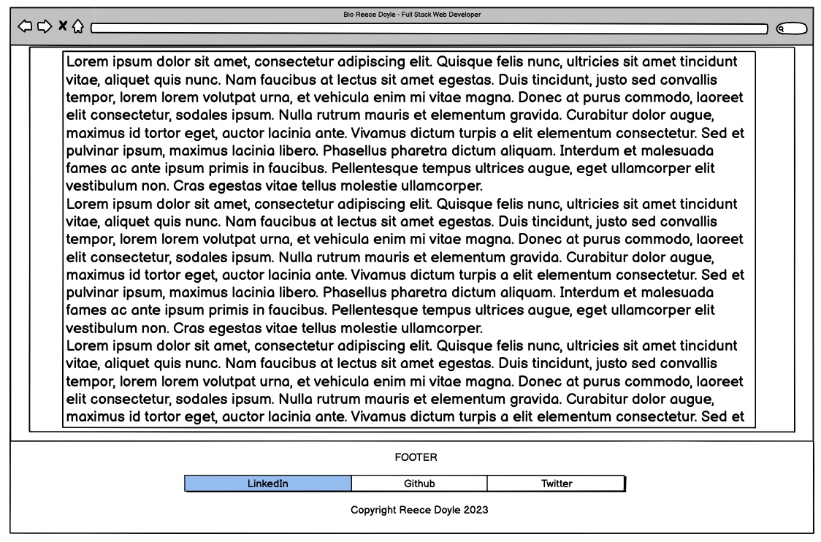
Bio - Desktop

Slide 26
Article Section
Transparent background
Small margin to allow background picture to be seen
Bio - Desktop
Footer
Visible only at full scroll

Slide 27
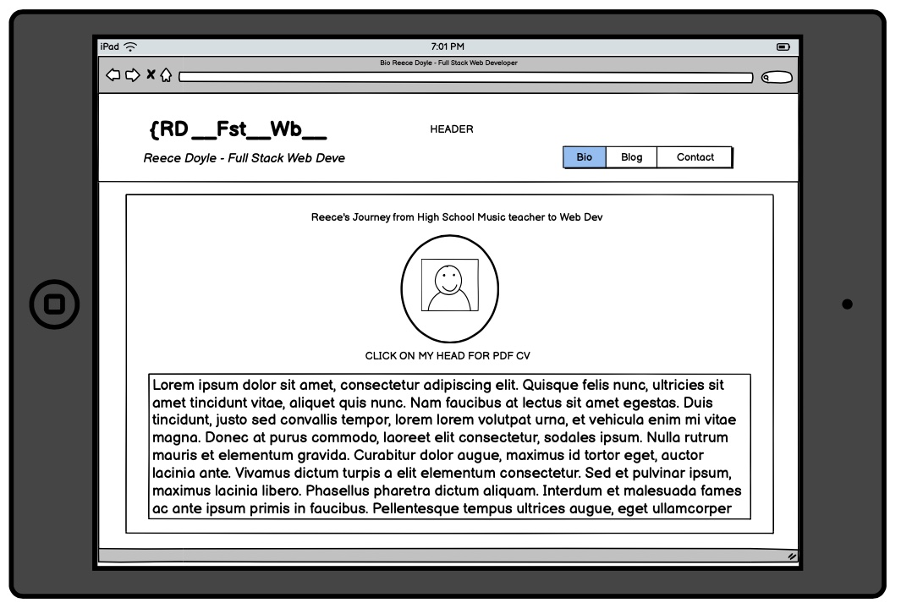
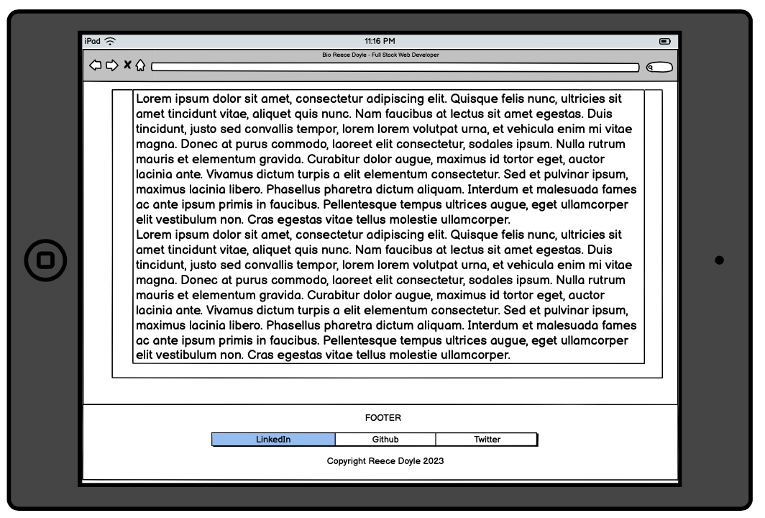
Bio - Tablet
Looked the same as Desktop without any breakpoints!!! Woo!

Slide 28
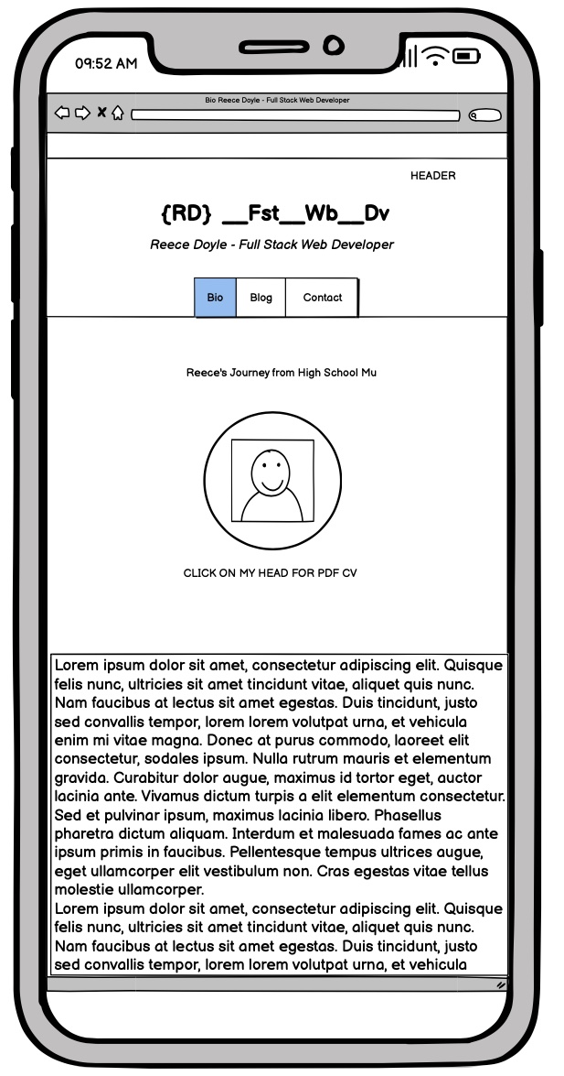
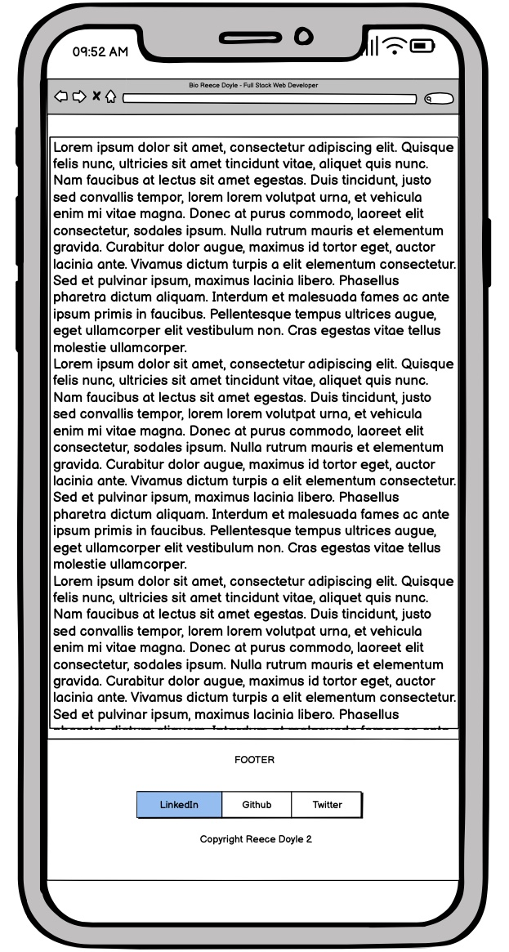
Bio - Mobile

Slide 29
Bio - Mobile
Article section
Removed Margin to maximise space
Portrait from 300px to 180px
Font-size for figcaption from 1.6rem to 1rem
Footer
Visible only at full scroll

Slide 30
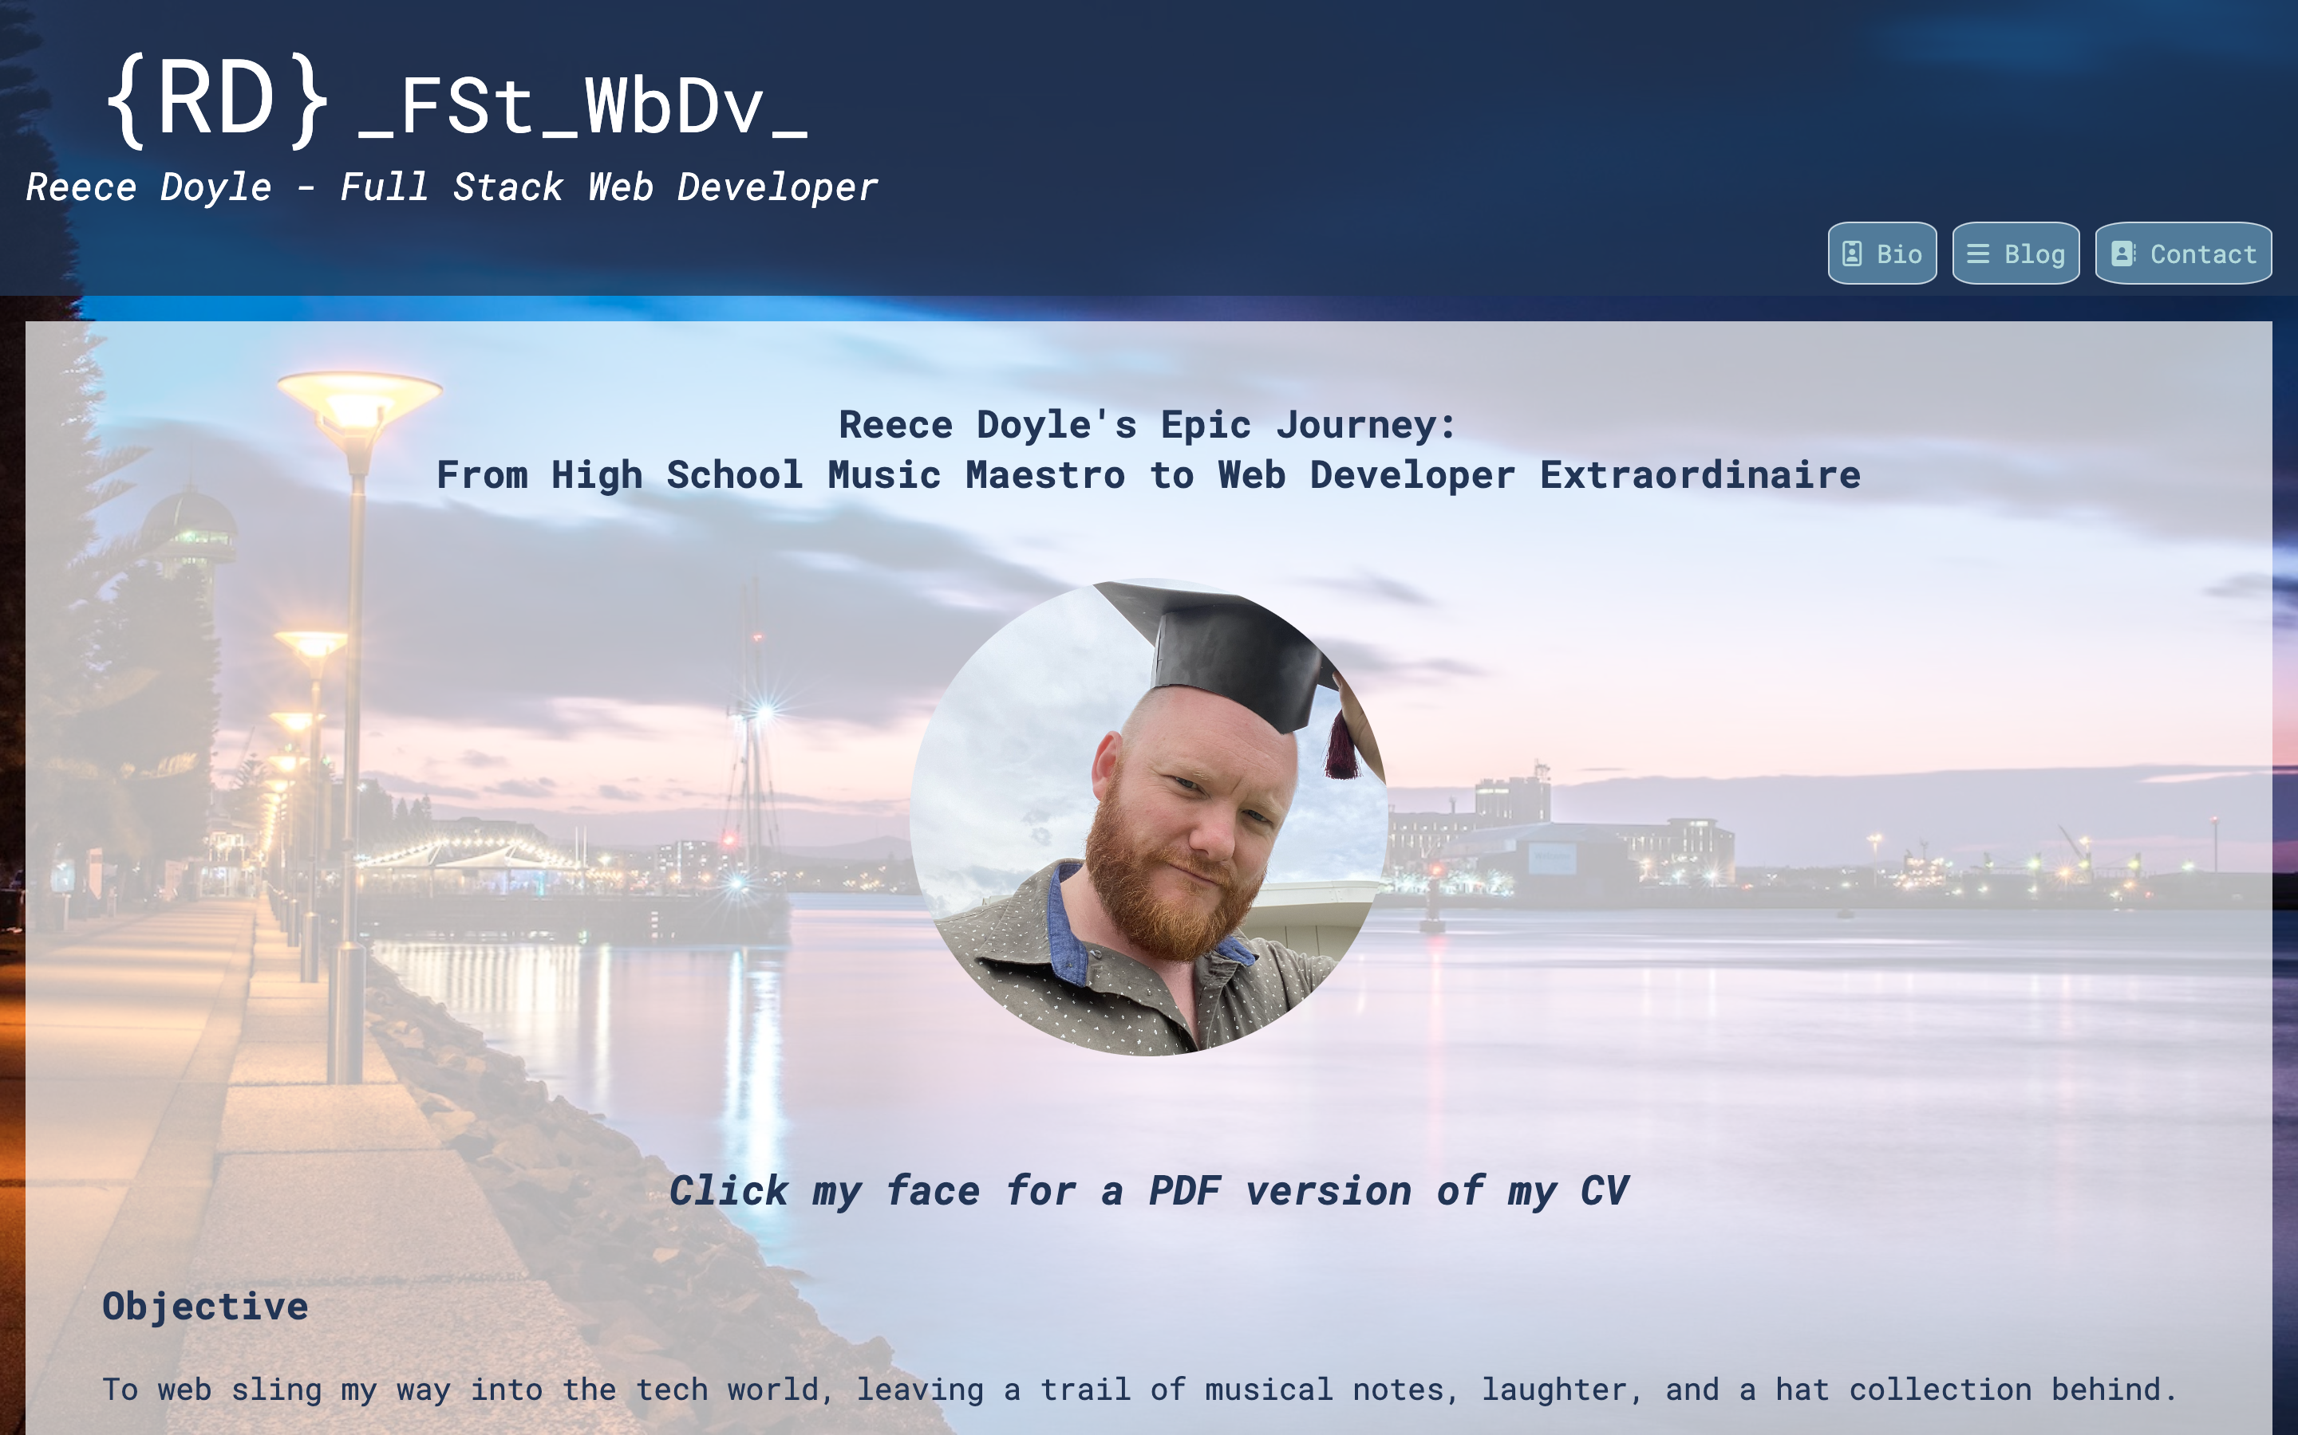
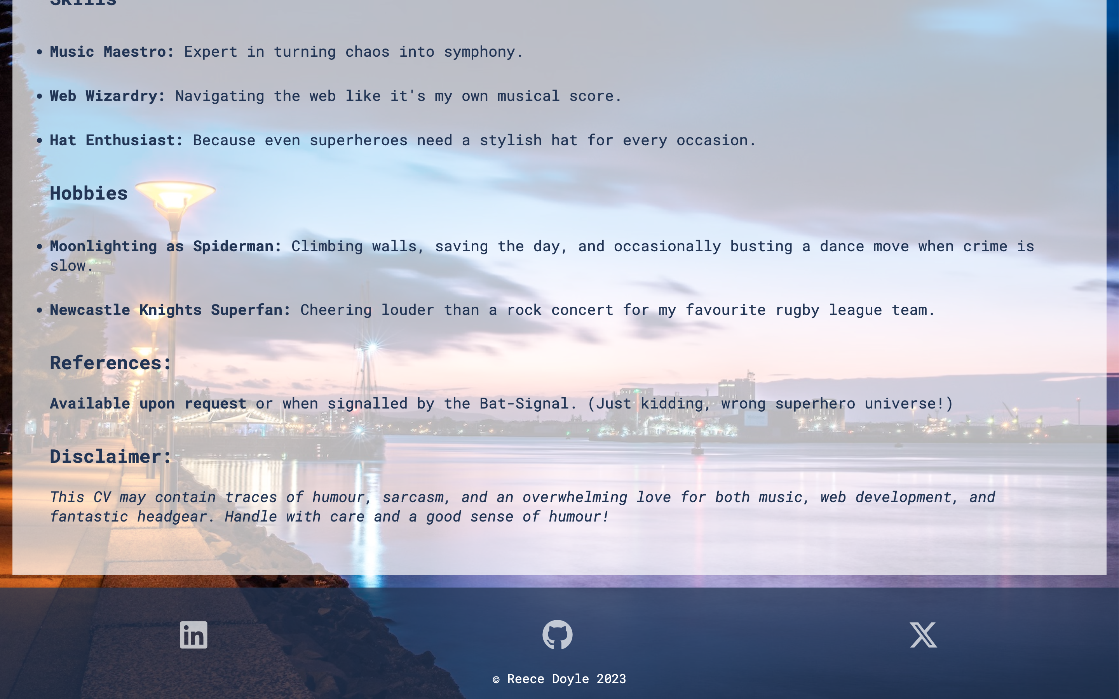
Bio - Desktop

Slide 31
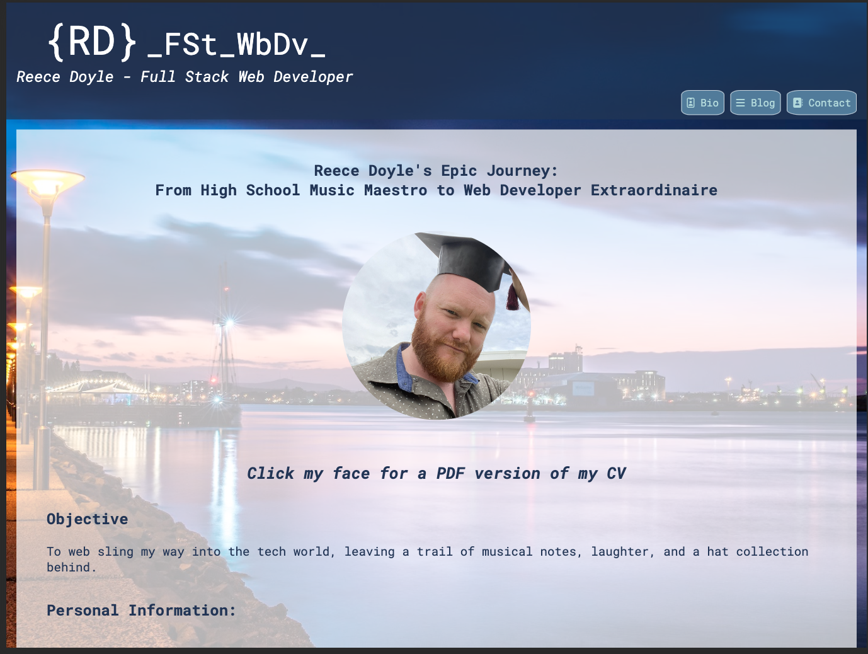
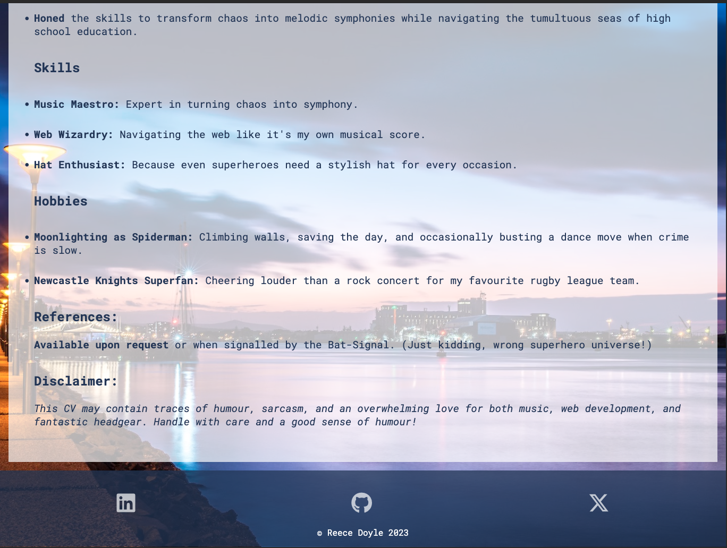
Bio - Tablet

Slide 32
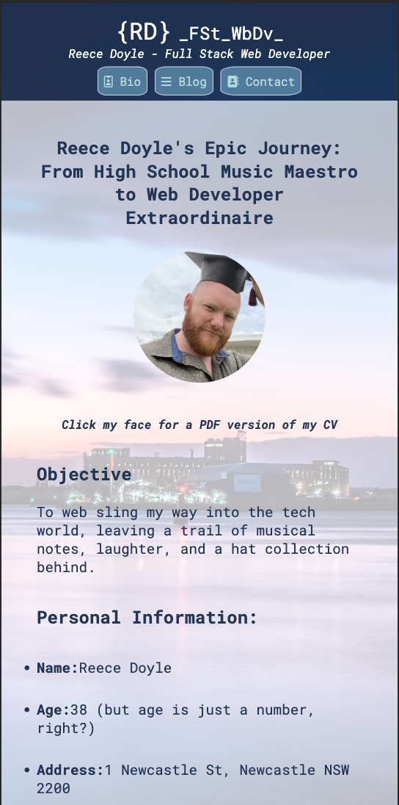
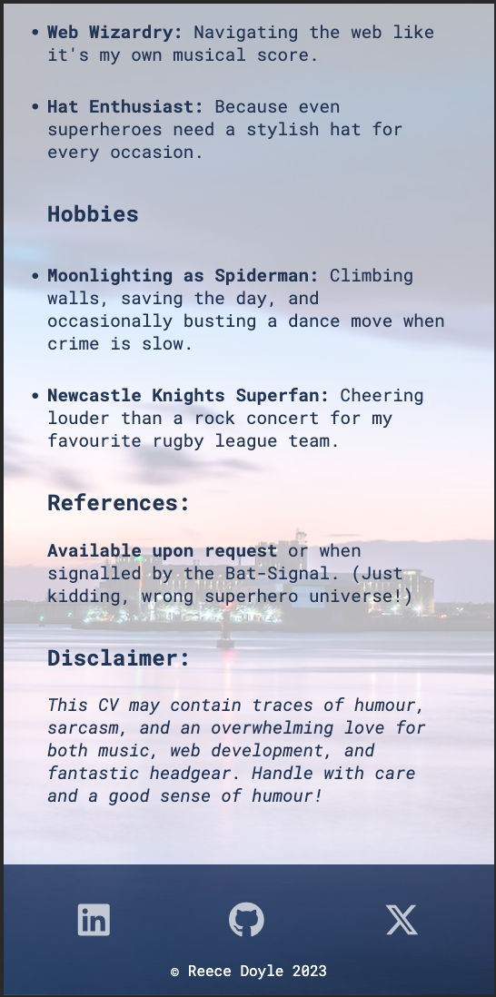
Bio - Mobile

Slide 33
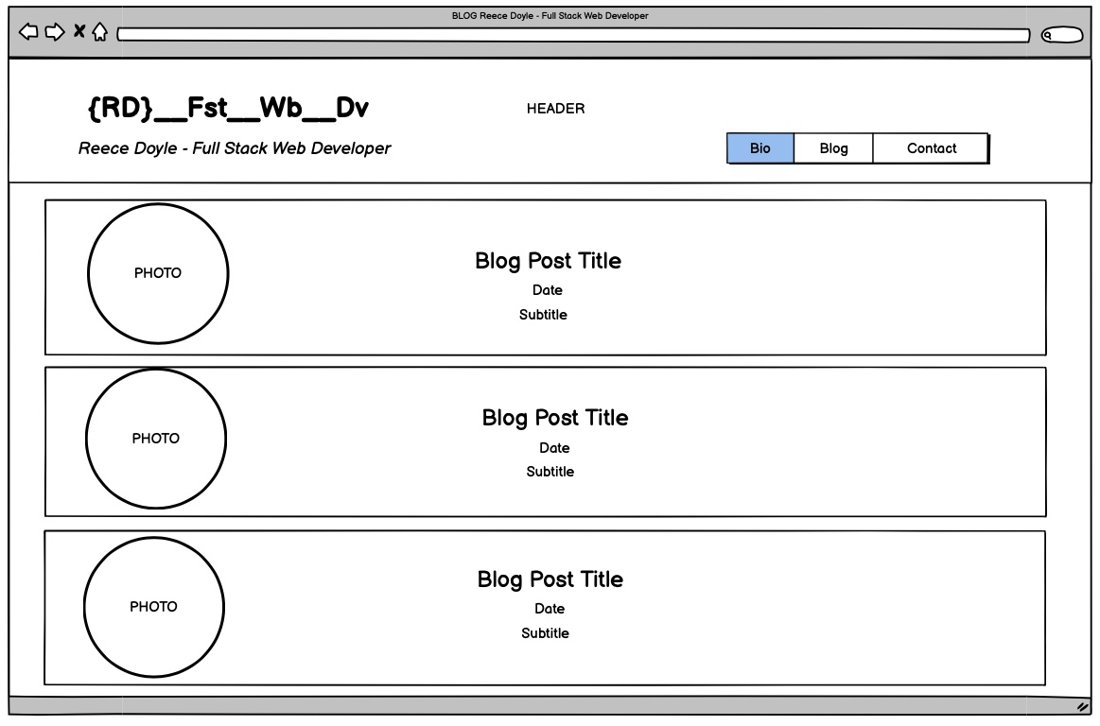
Blog - Desktop

Slide 34
Blog - Desktop
Article sections
Blog posting is a link
Round pictures 20vh
Title, date, and subtitle
1rem margin and padding

Slide 35
Blog - Desktop
Article sections
Blog posting is a link
Round pictures 20vh
Title, date, and subtitle
1rem margin and padding
Article sections
Red Border at hover

Slide 36
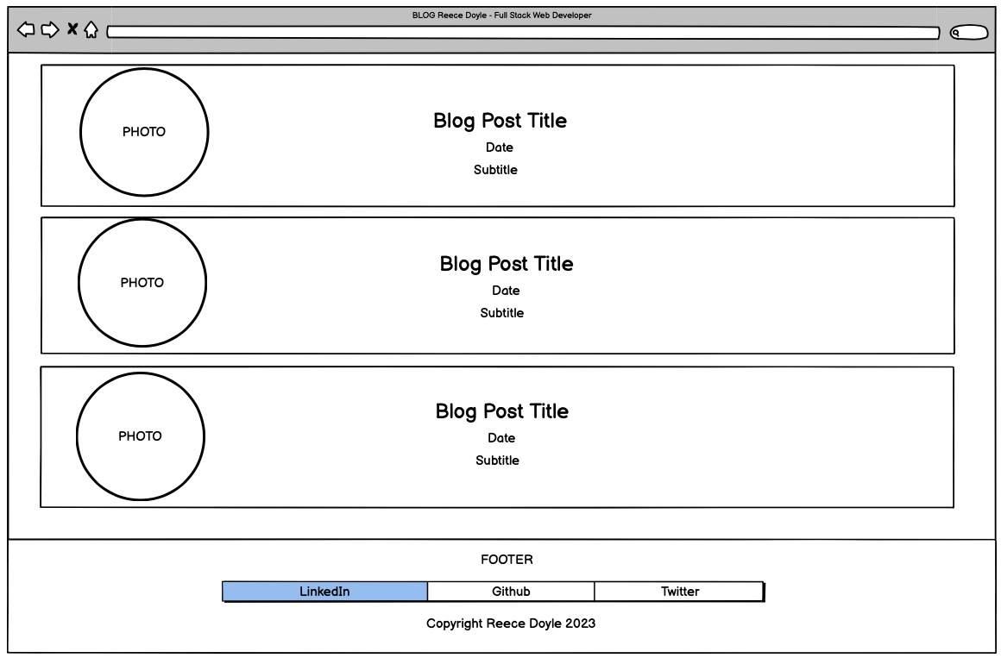
Blog - Desktop
Footer
Visible only at full scroll

Slide 37
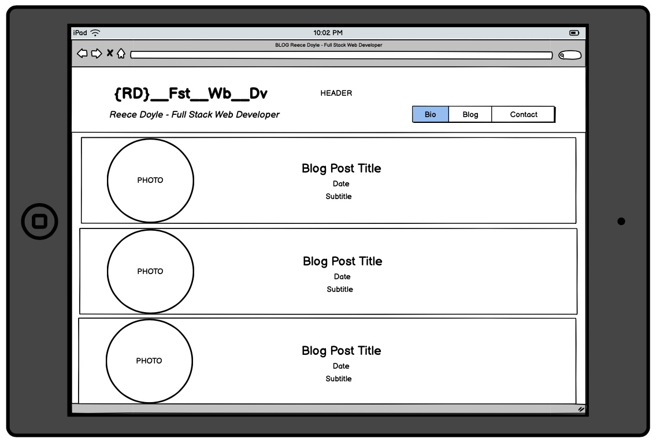
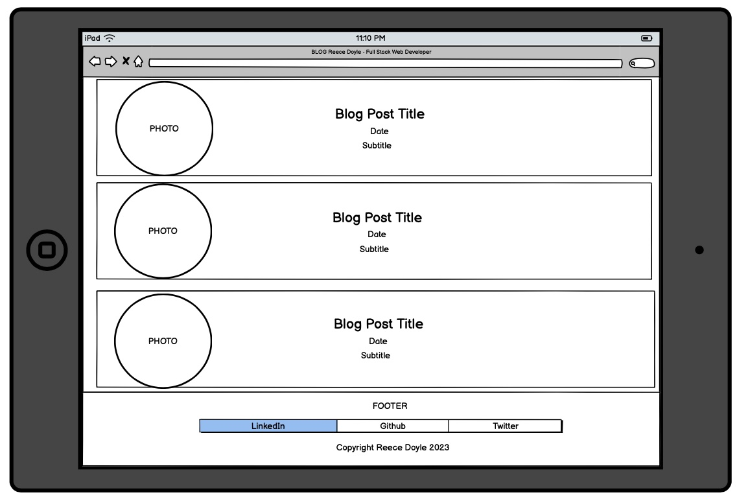
Blog - Tablet
Looked the same as Desktop without any breakpoints!!! Woo!

Slide 38
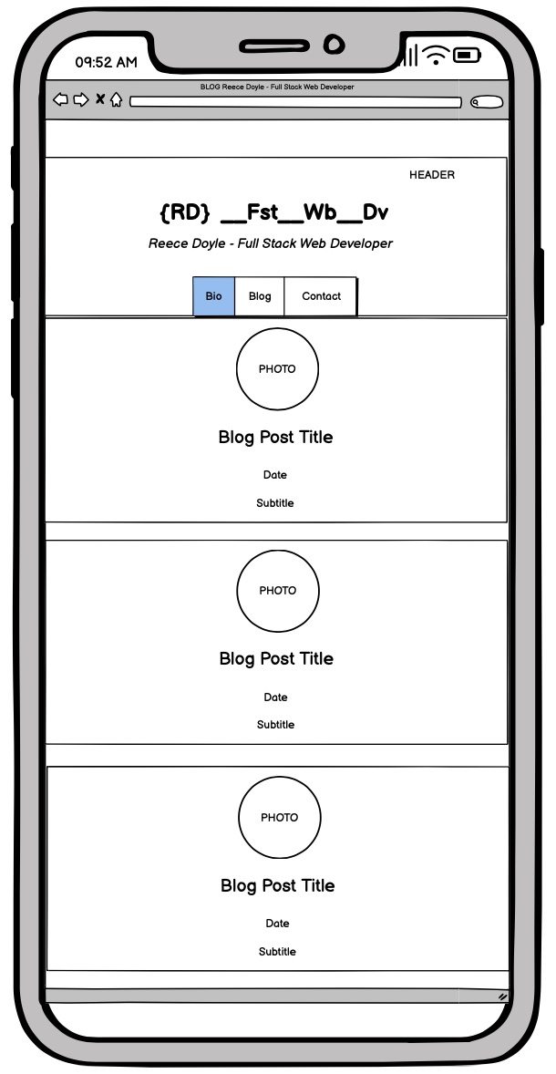
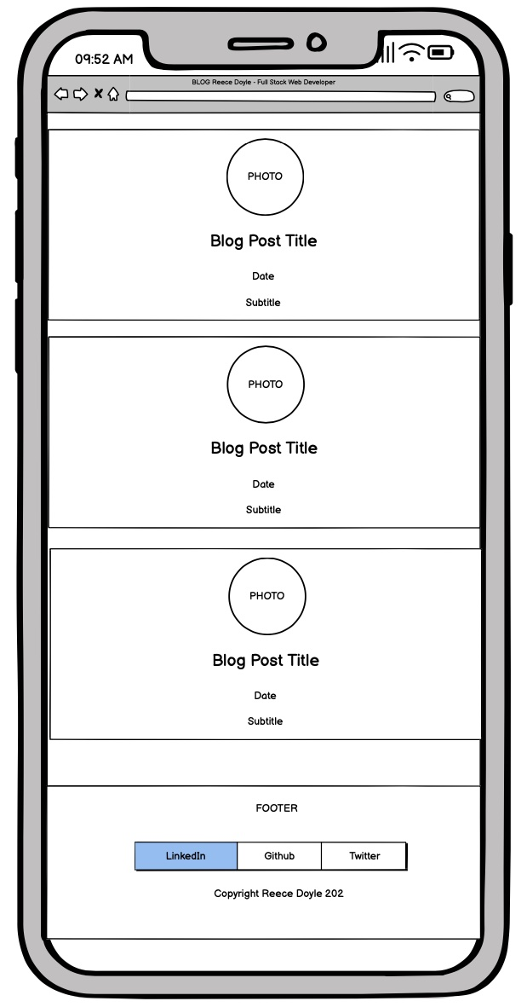
Blog - Mobile

Slide 39
Blog - Mobile
Article sections
Flex-direction row to column
Margin now only 0.5 rem top and bottom
Footer
Visible only at full scroll

Slide 40
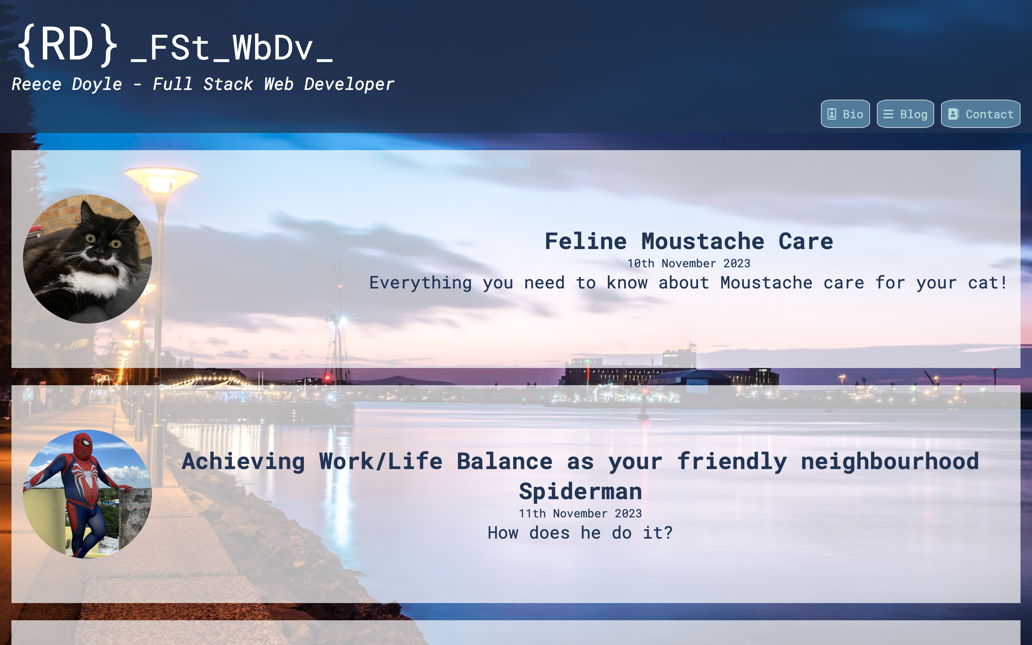
Blog - Desktop

Slide 41
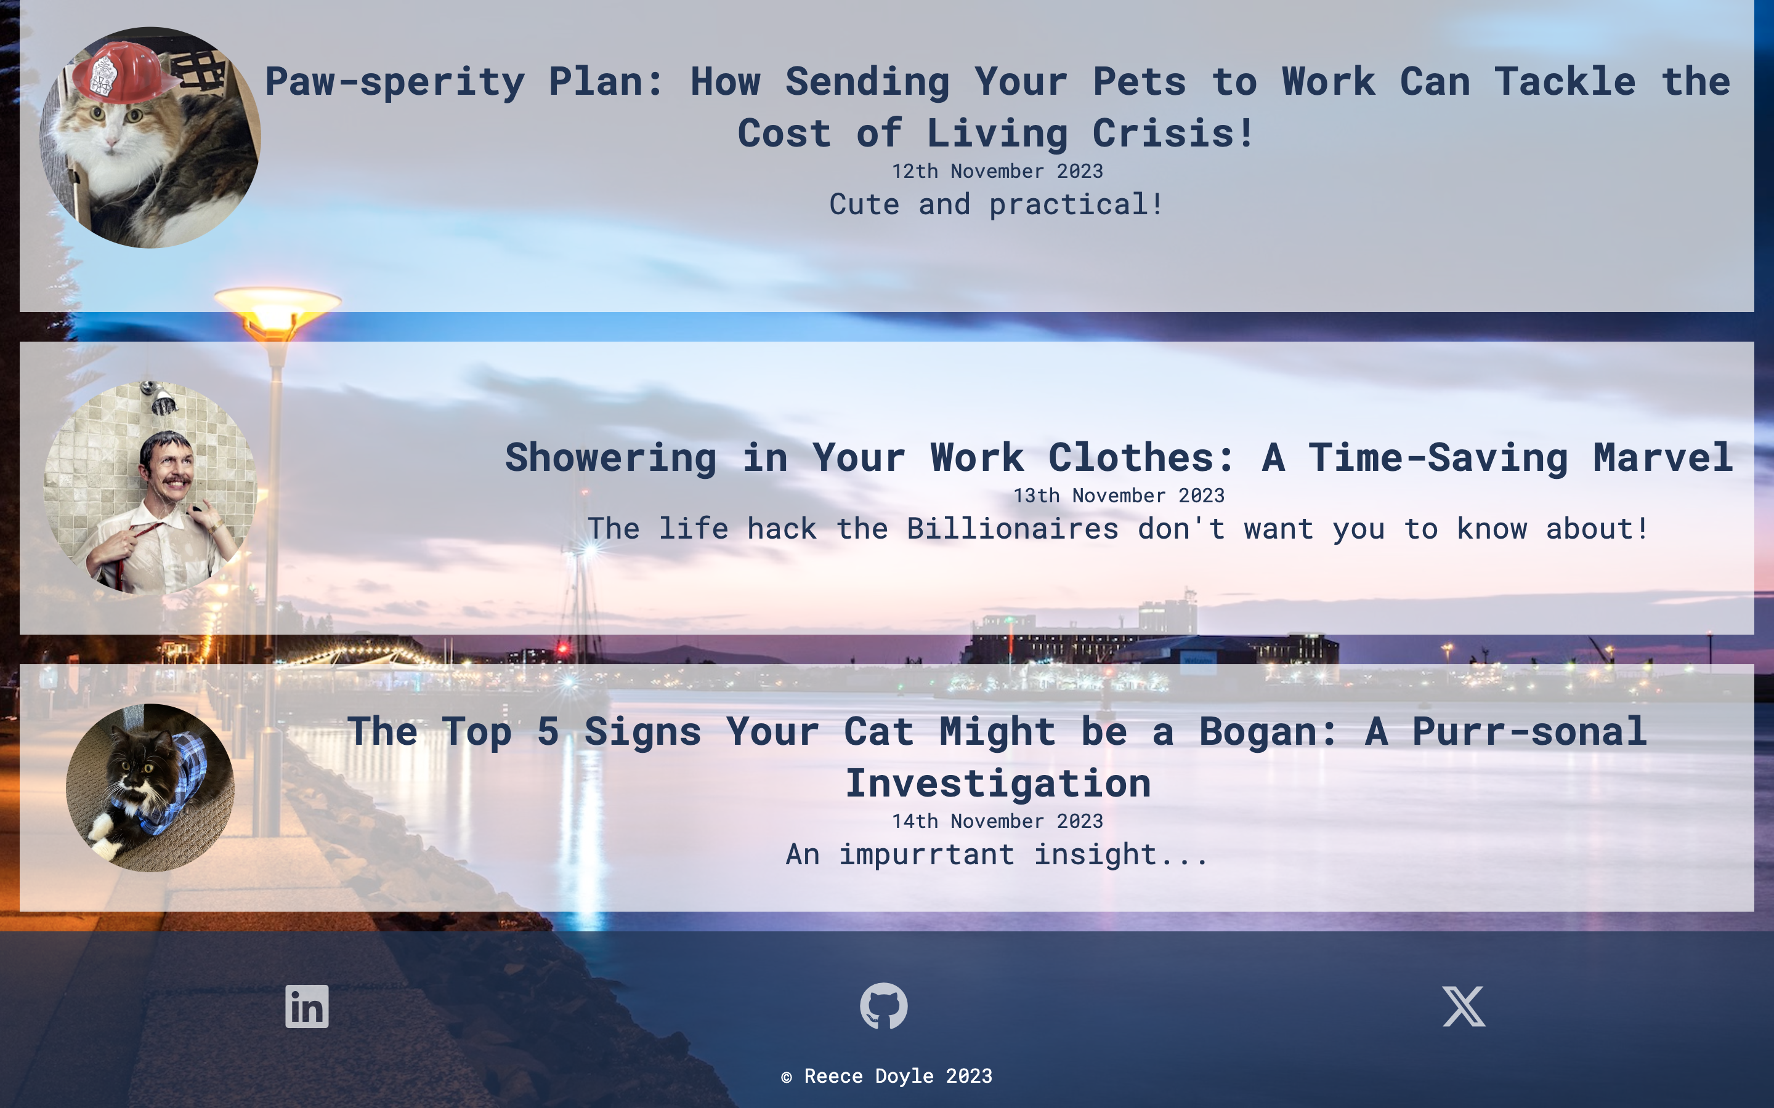
Blog - Desktop

Slide 42
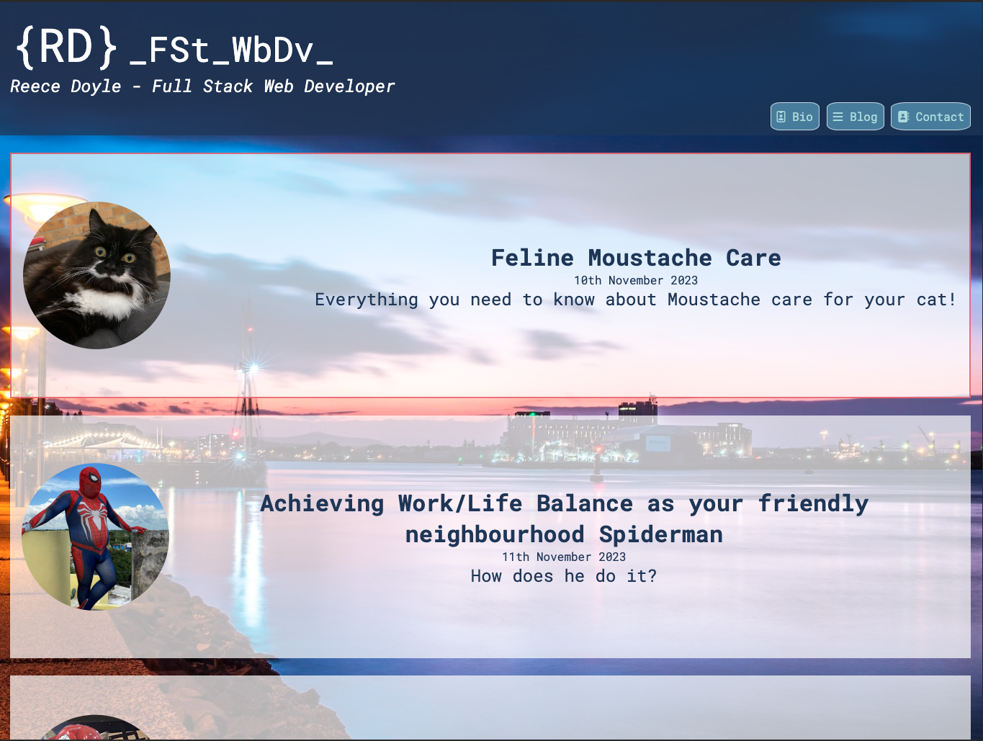
Blog - Tablet

Slide 43
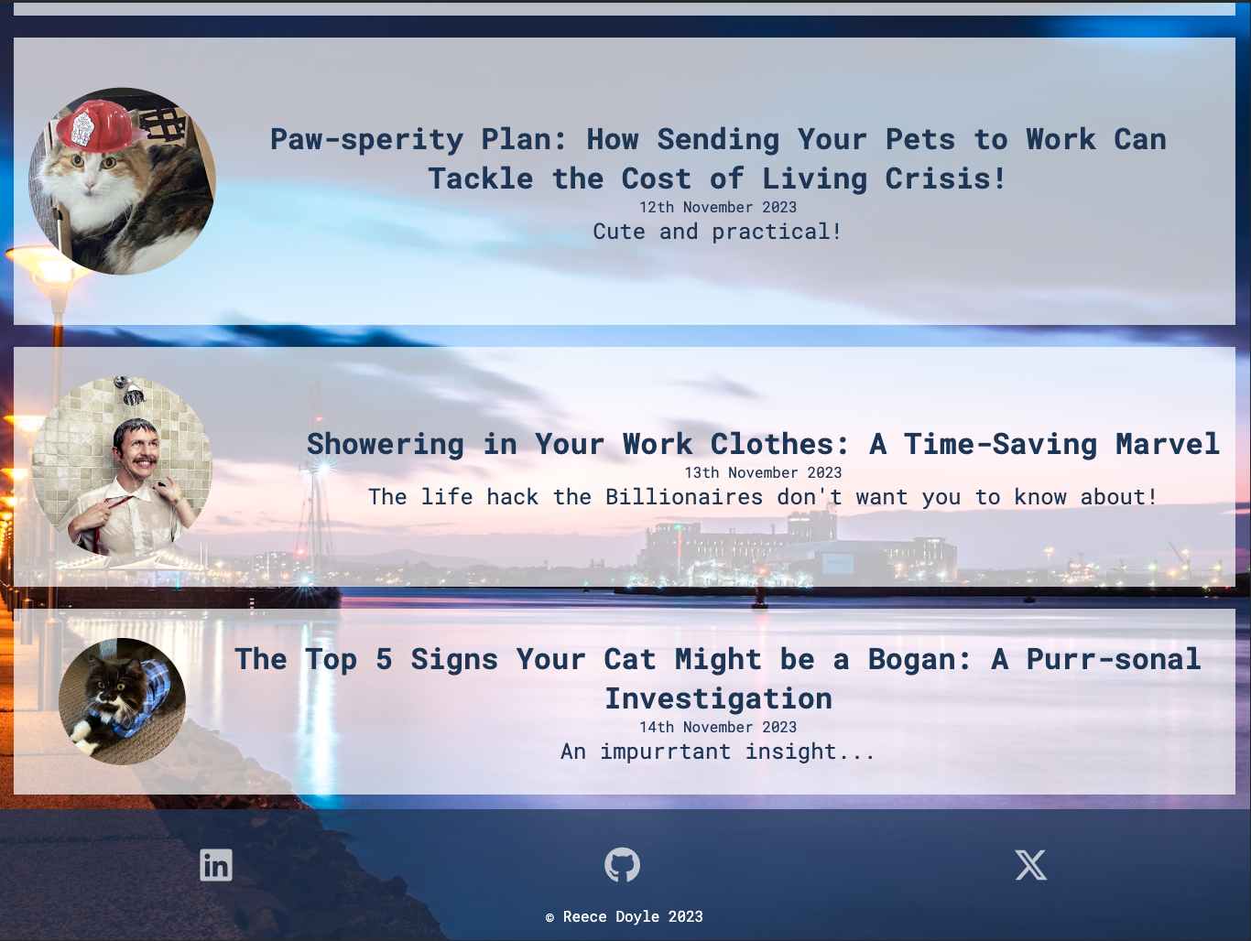
Blog - Tablet

Slide 44
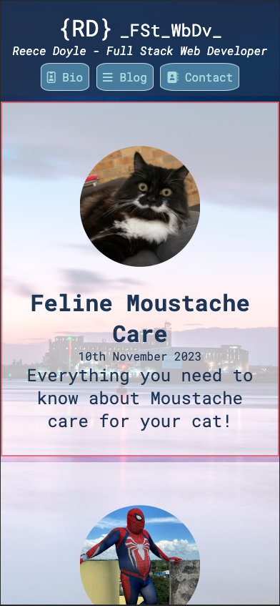
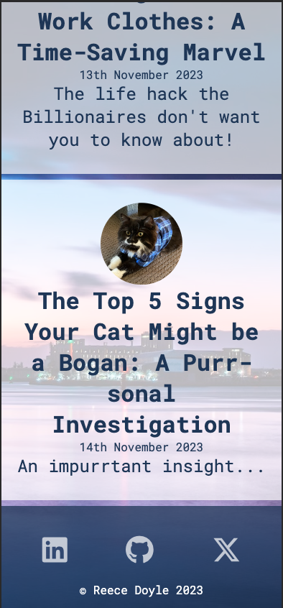
Blog - Mobile

Slide 45
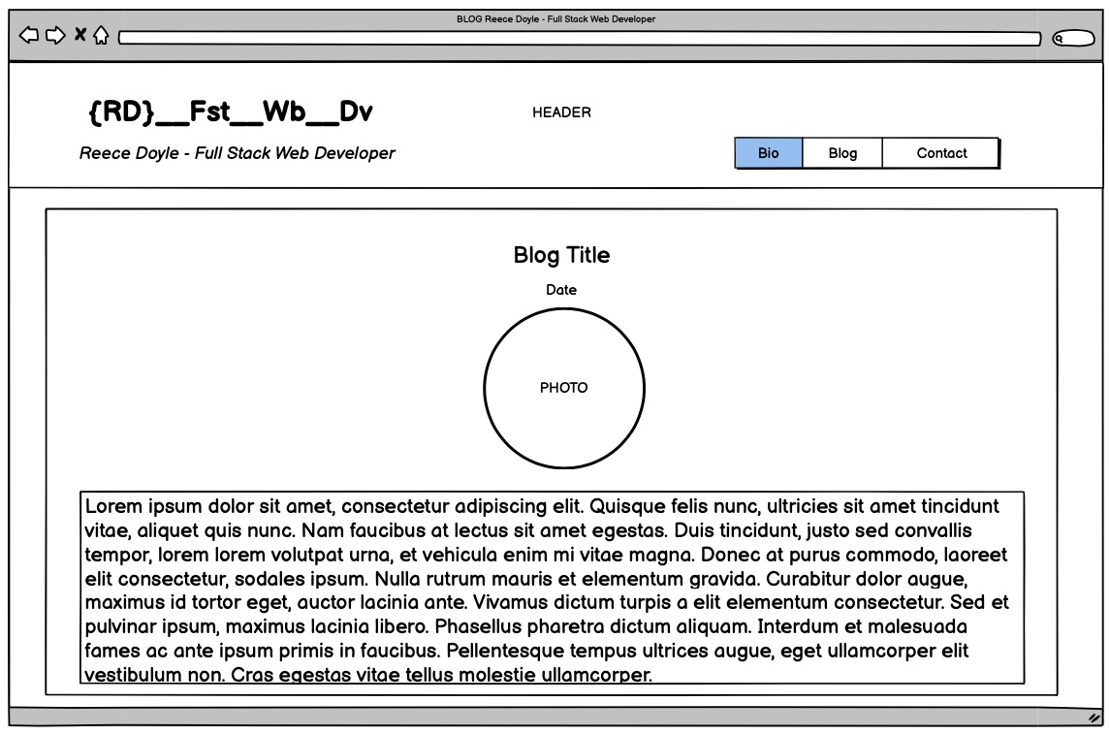
Blogpost - Desktop

Slide 46
Blogpost - Desktop
Article sections
Image width 50% and circle
ChatGPT for article content

Slide 47
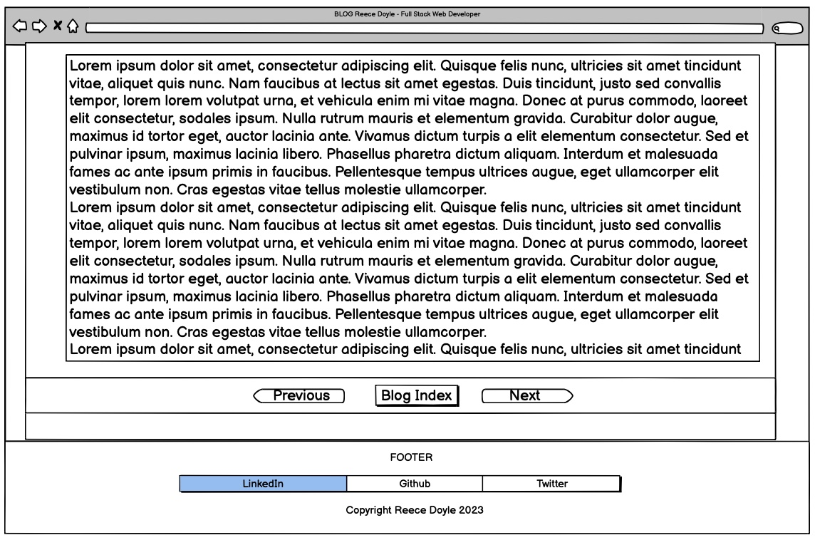
Blogpost - Desktop

Slide 48
Blogpost - Desktop
Links sections
Move between articles
Matches navbar and header styling
Footer
Visible only at full scroll

Slide 49
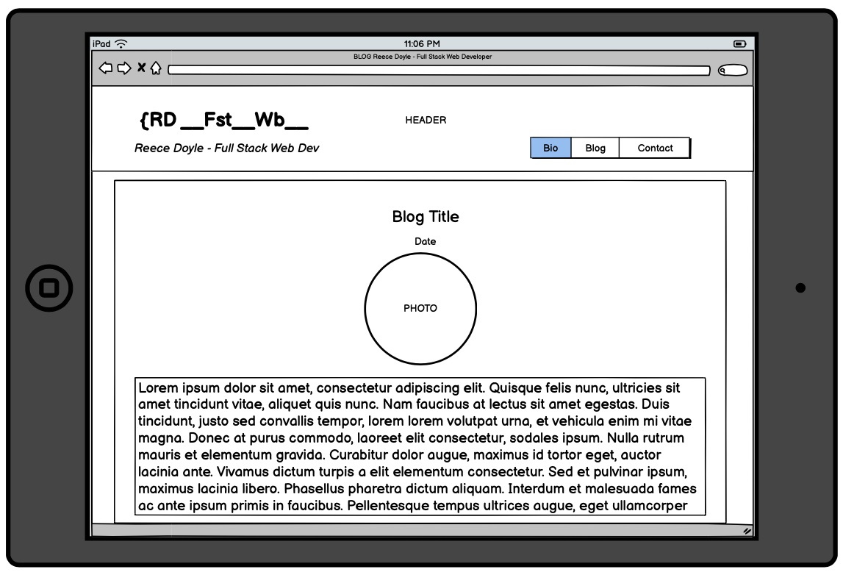
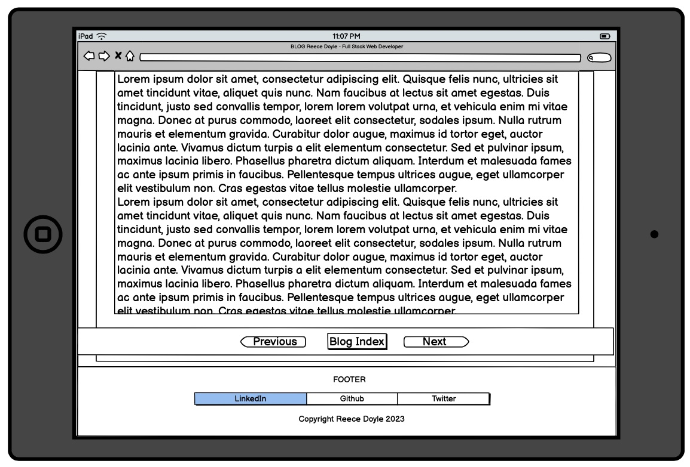
Blogpost - Tablet
Looked the same as Desktop without any breakpoints!!! Woo!

Slide 50
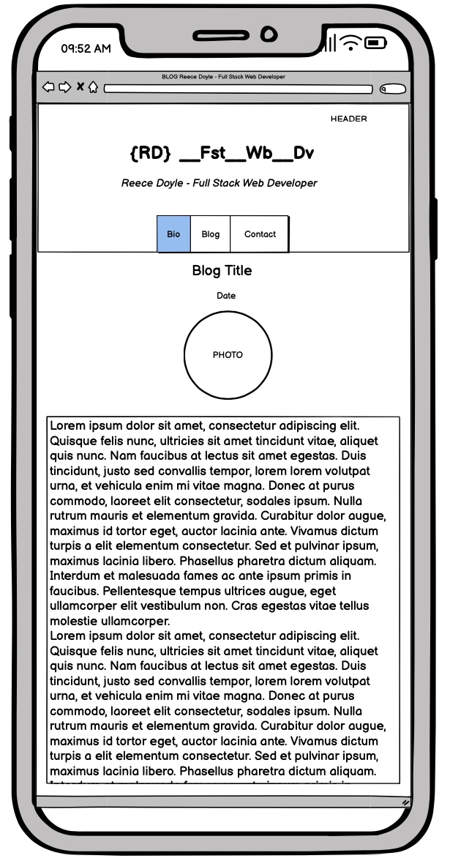
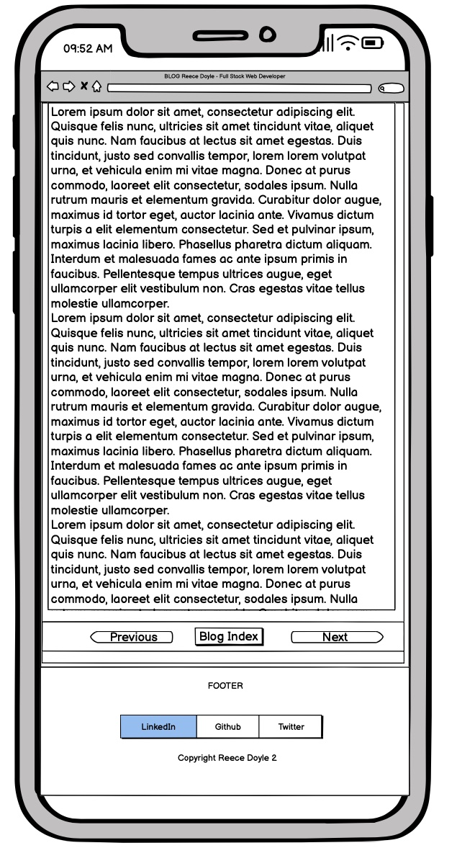
Blogpost - Mobile

Slide 51
Blogpost - Mobile
Article sections
Removed margin
H1 from 2.5rem to 1.25rem
P from 1.5rem to 1rem
Links section
Padding from 2rem to 0.2rem
Footer
Visible only at full scroll

Slide 52
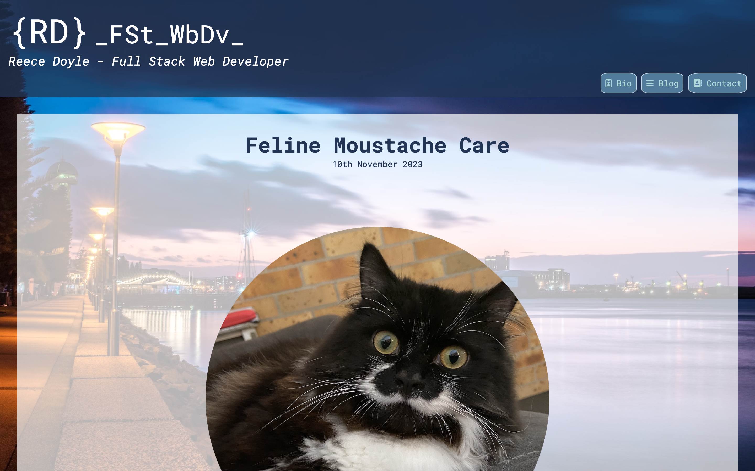
Blogpost - Desktop

Slide 53
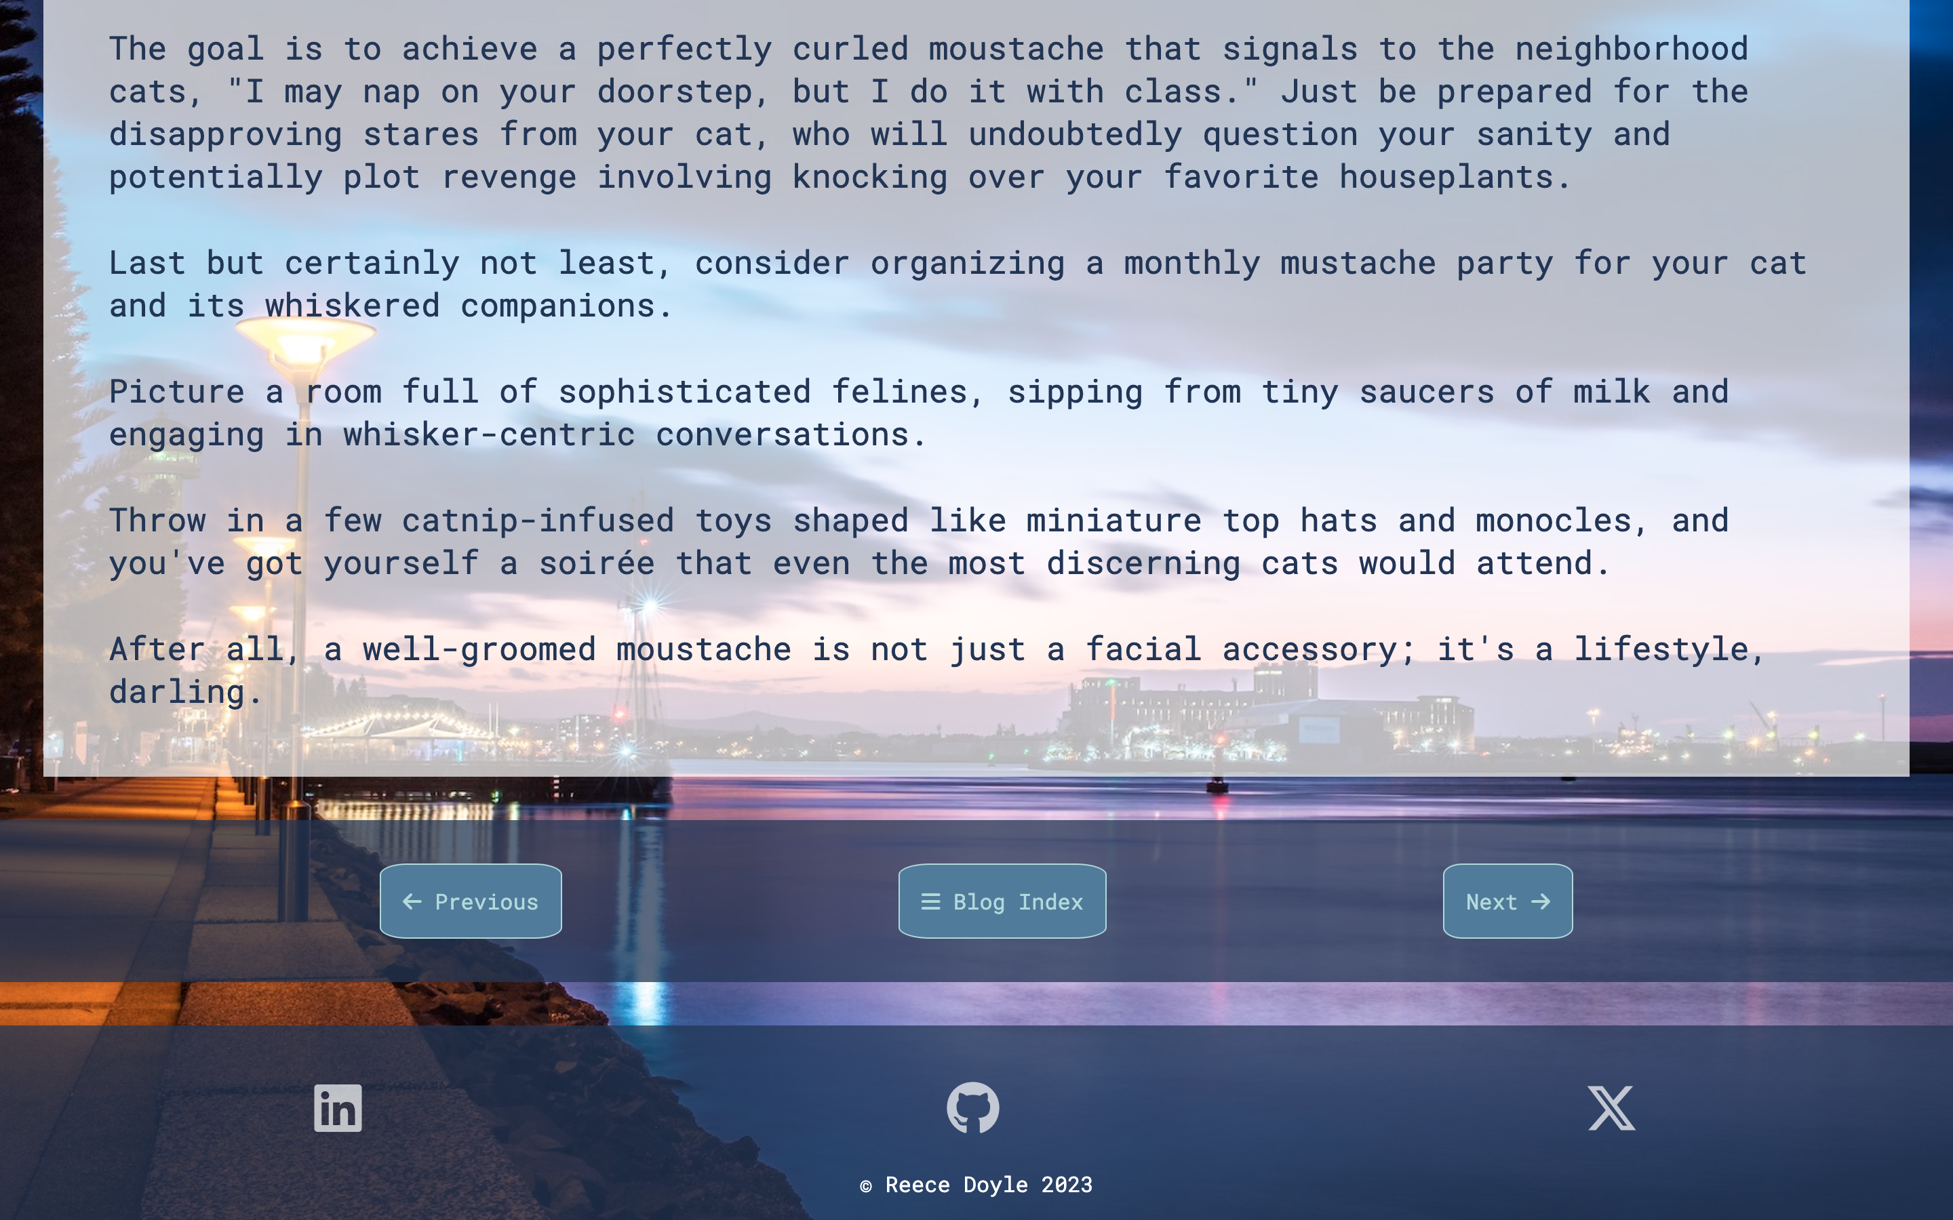
Blogpost - Desktop

Slide 54
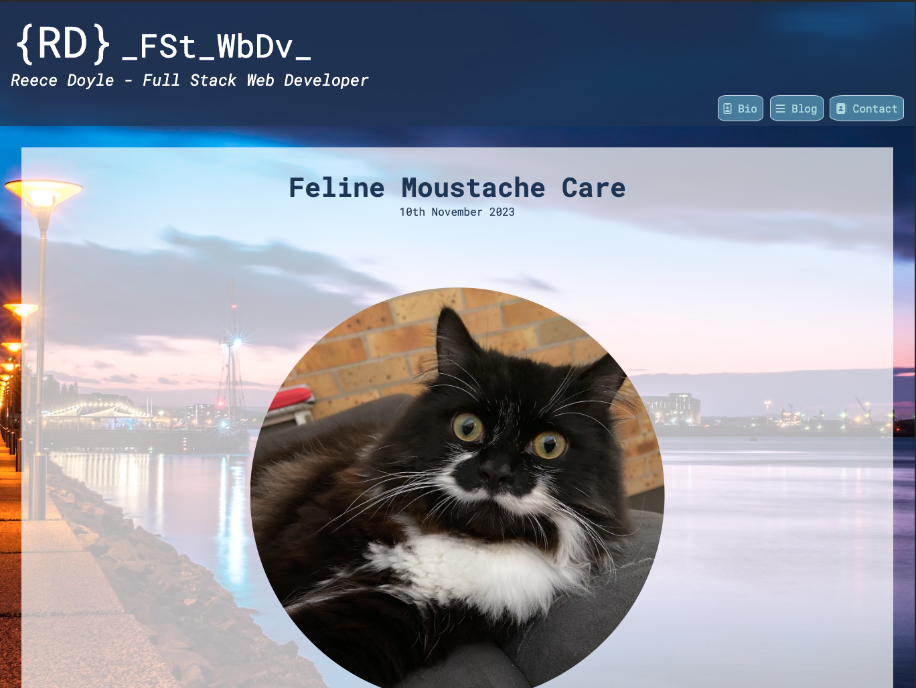
Blogpost - Tablet

Slide 55
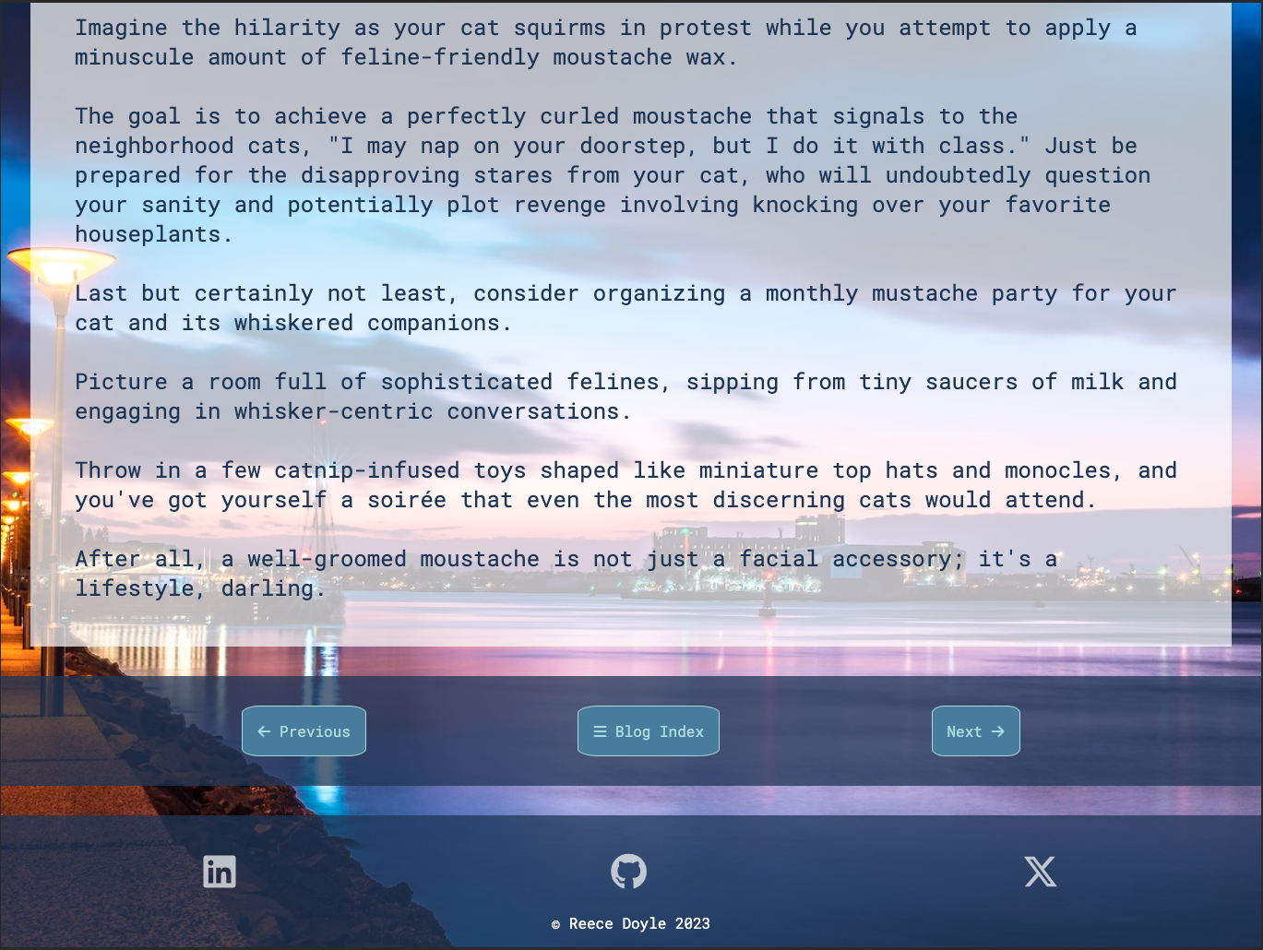
Blogpost - Tablet

Slide 56
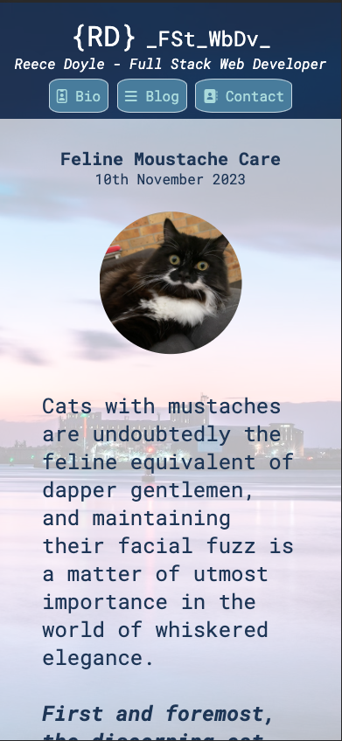
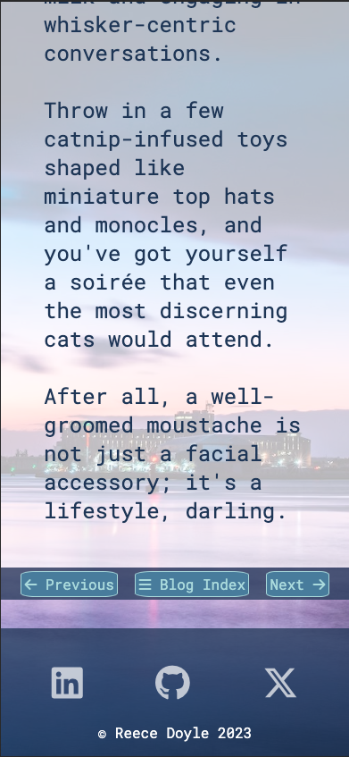
Blogpost - Mobile

Slide 57
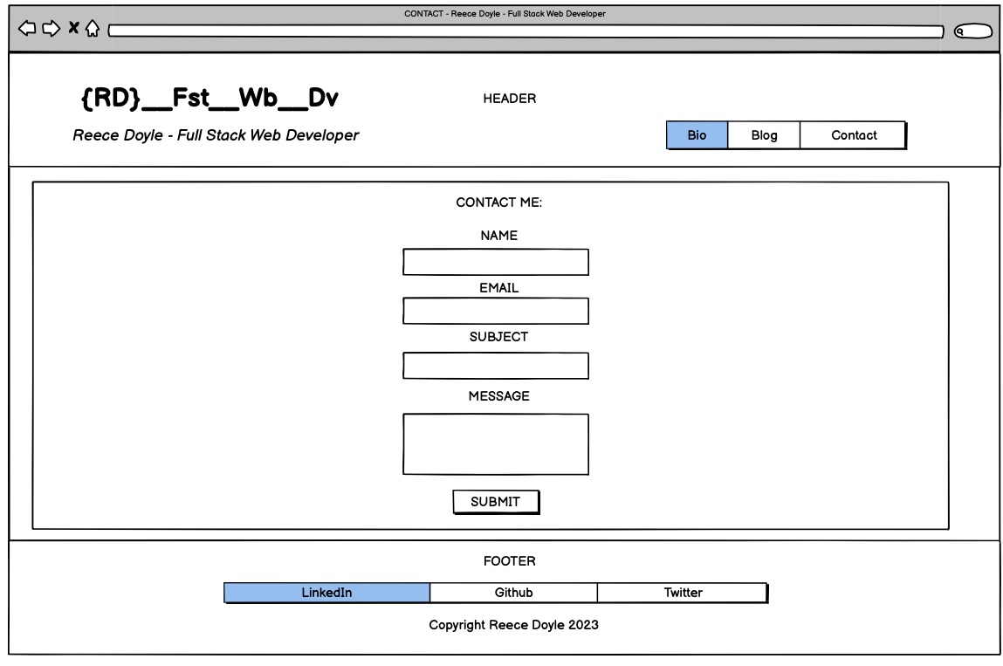
Contact - Desktop

Slide 58
Contact - Desktop
Main section
100vh with margin of 1rem
Form Div.
100% width
50% form input
Submit button matches navbar styling

Slide 59
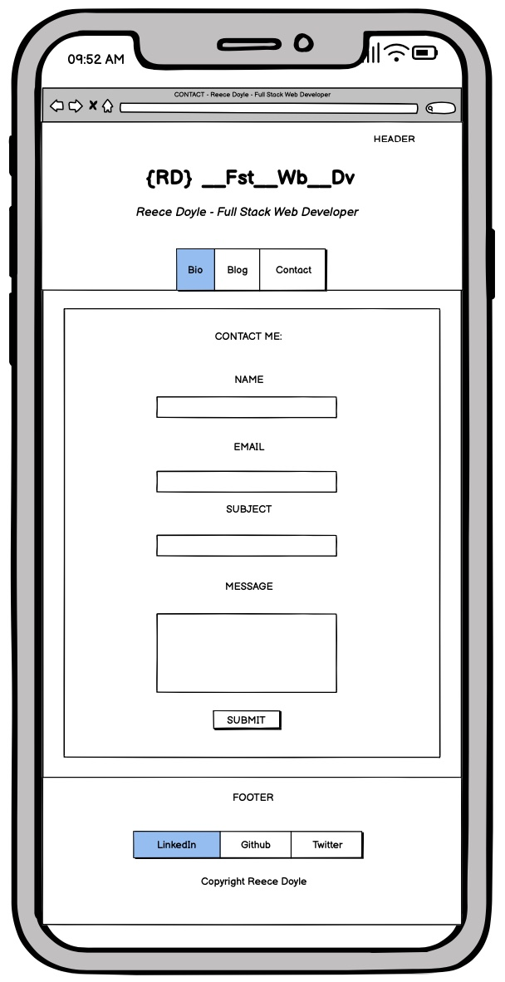
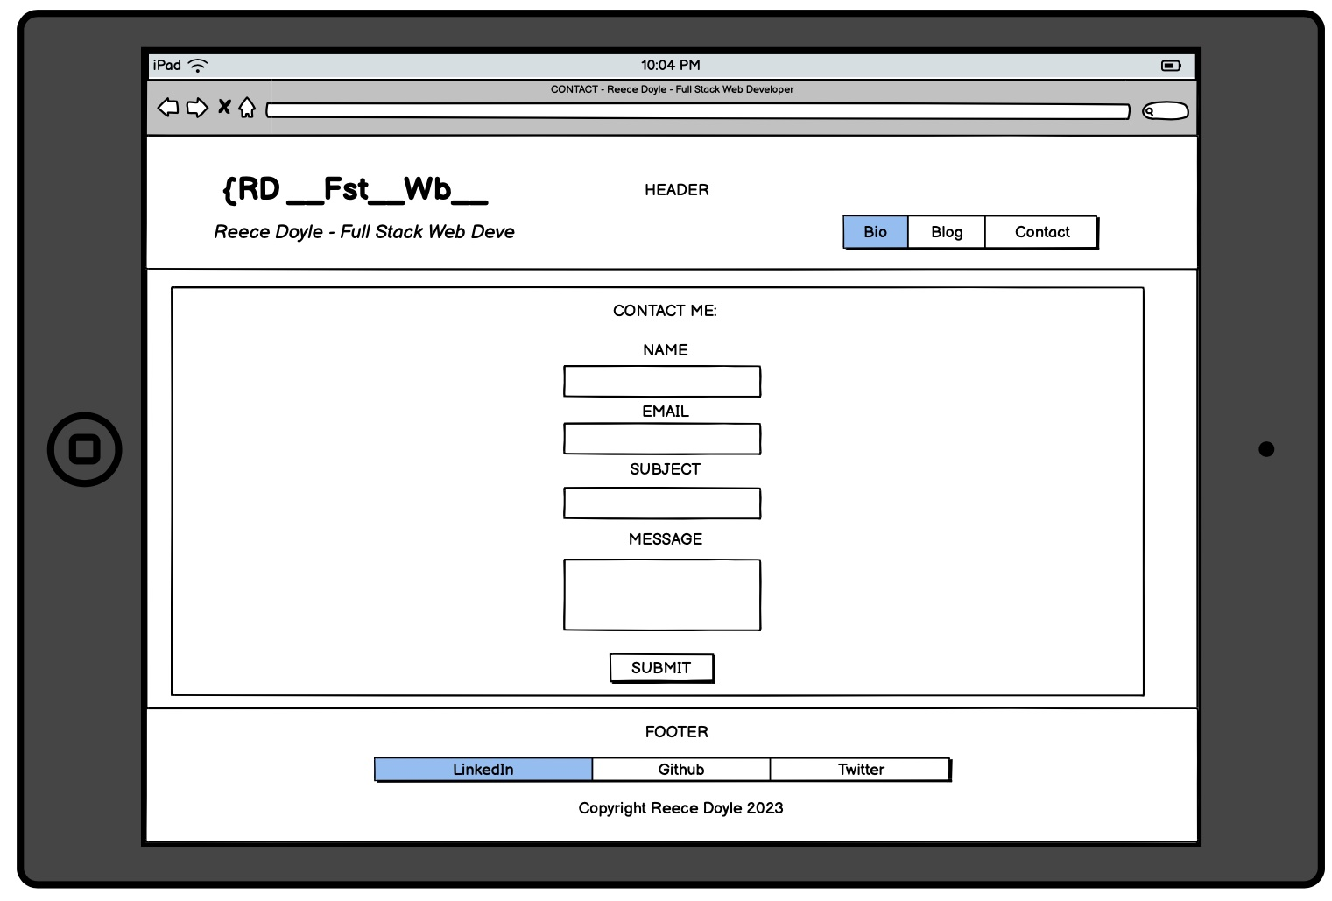
Contact – Tablet & Mobile
Looked the same as Desktop without any breakpoints!!! Woo!
No media query required!

Slide 60
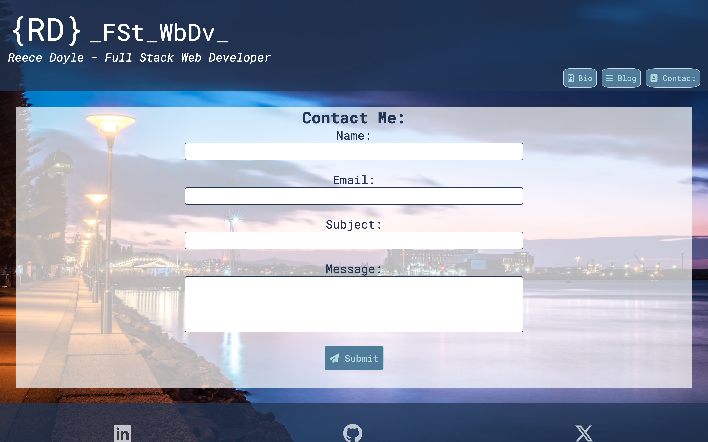
Contact - Desktop

Slide 61

Contact – Tablet

Slide 62

Contact - Mobile

Slide 63
Challenges, Ethical Issues, Favourite pats

Slide 64


Challenges
Broken Header: Couldn’t make the logo sit on the left with the navbar on the right.
Solution: align-items: flex-start; and margin-left: auto;
Floating Footer: Footer was halfway up the page instead of at the bottom.
Solution: Flexbox on the body container and flex-direction: column;

Slide 65


Challenges
Broken Header: Extra margin at the top of the page.
Solution: adding this reset to index.scss

Slide 66


Challenges
Couldn’t modify font-size: My media query was changing the font-size at above 600px instead of below

Slide 67



Challenges
Couldn’t modify font-size: My media query was changing the font-size at above 600px instead of below
Solution: } in the wrong spot. Just had to move the .contact-section up 2 lines

Slide 68
Ethical Issues
Worrying about “stealing” code.
Initially, I was concerned about the integrity of using any code I might have to find somewhere else without citing.
I realised that it’s not the same as stealing a melody or lyrics in a song. Coding is simply too varied, and it’s more just about applying rules.
There was very little if any code that I needed from an outside source anyway. I avoided using a stylesheet from elsewhere because I felt I wouldn’t learn as much, and it would probably take longer modifying someone else's code than just trying my own first.

Slide 69










Favourite Parts
I did it! (I’m not from a tech background). I learned so much!
Love the colours!
ChatGPT made it funny and motivated me.
The buttons and logos change colour!
A fun way to express my humour!
The pic of Newcastle worked so well with the colours I’d already picked.
It features our cats!
Freddie Purrcury
Purrincess Zelda

Slide 70
Thank you for your time!

